Slide 1

Welcome to the Department of English!

Slide 2
Overview ICB
A study program that has been constructed for 6 semesters (180 CPs in total):
  80 CPs in your English major (“Hauptfach”)
  48 CPs in your Business and Economics minor (“Nebenfach”)
  12 CPs in Commercial Law (“Wirtschaftsrecht”)
  20 CPs in a second business language (“Zweite Wirtschaftssprache”)
Second business langauges that can be combined with an English major:
  In the Romance Language Department: Spanish, French, or Portuguese
  In the Slavic Language Department: Russian, Polish, Czech, Ukrainian, or Croatian / Serbian / Bosnian
After you graduate with a B.A. in ICB, you will be qualified for an M.A. at the JLU:
  M.A. Intercultural Communication and Business (ICB)
  M.A. Anglophone Studies
  M.A. Romanistik
  M.A. Slavistik
CP = credit points

Slide 3
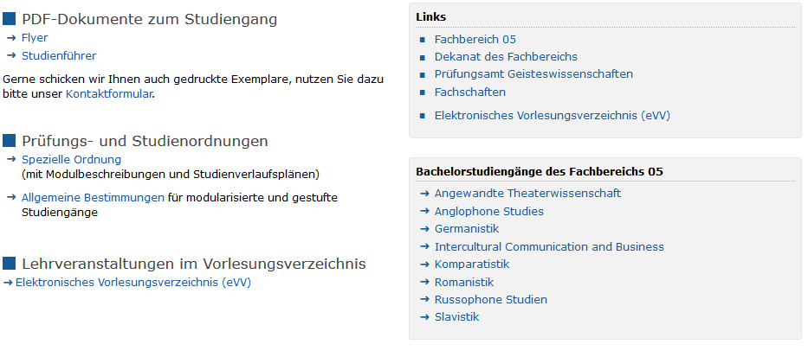
All you need to know about the “Prüfungs- und Studienordnung”
How to find it (starting from the JLU homepage):
Studium → Studienangebot → Bachelorstudiengänge → Intercultural Communication and Business (ICB) →

Slide 4
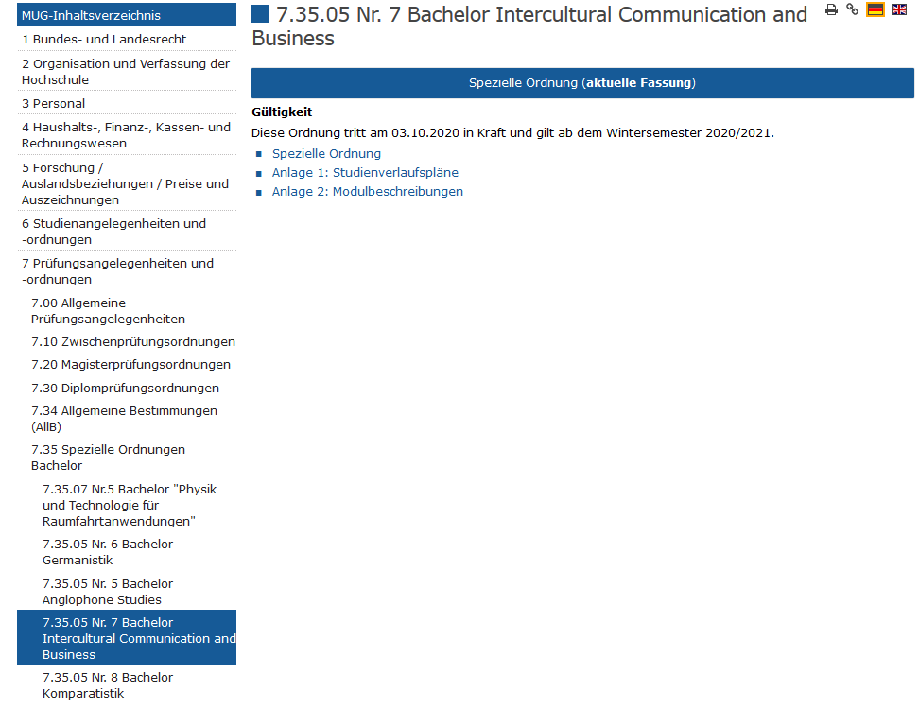
All you need to know about the “Prüfungs- und Studienordnung”
MUG = Mitteilungen der Universität Gießen (official documents like your “Prüfungs- und Studienordung”)
Spezielle Ordnung = general structure and rules of the study program, e.g. “Die Regelstudienzeit beträgt 6 Semester”
Studienverlaufsplan = a guideline to use when planning which courses to take
Modulbeschreibungen = details about the content, structure, test forms, etc. of each module

Slide 5
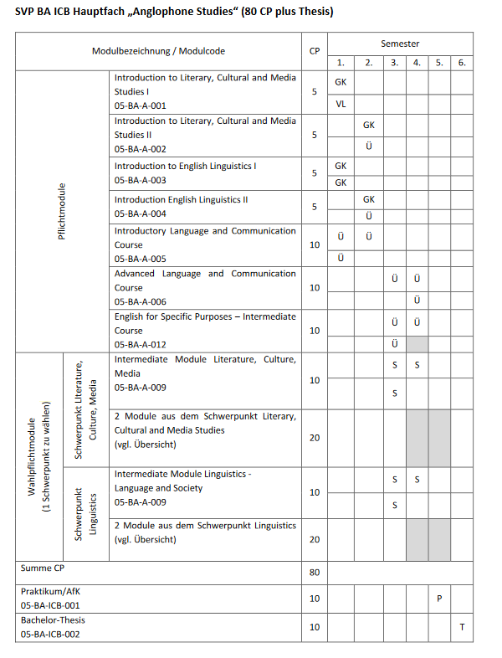
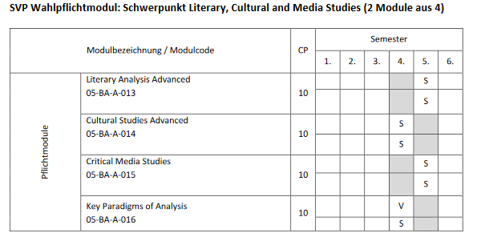
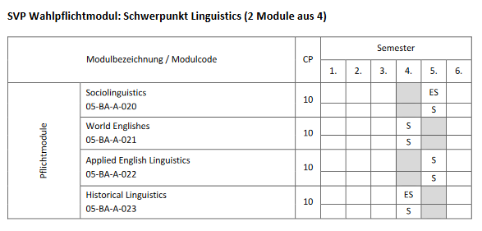
All you need to know about the “Verlaufsplan”
Mandatory Modules
Elective Modules / Choice of Concentration
BA Thesis “im Schwerpunktbereich”

Slide 6
All you need to know about the “Verlaufsplan” – English Major
NOTE: These modules are important for your first semester!!

Slide 7
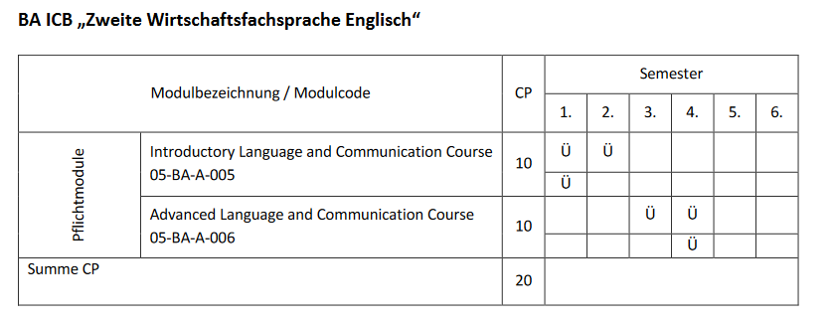
All you need to know about the “Verlaufsplan” – Second Business Language
NOTE: This module is important for your first semester!!

Slide 8
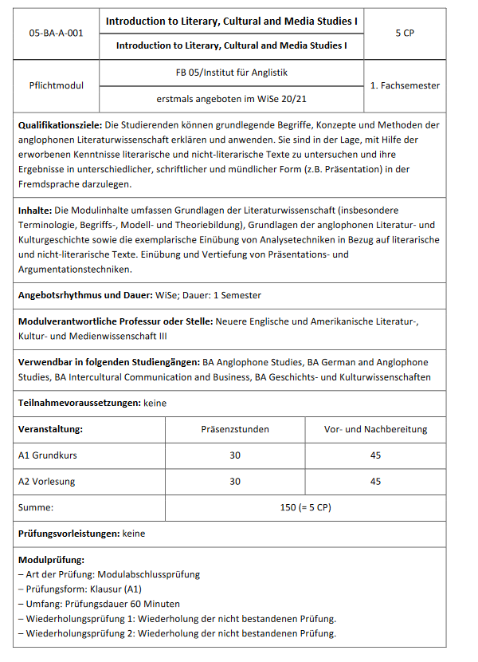
All you need to know about the “Modulbeschreibungen”
Courses for this Module in WiSe 20-21:
A1 Grundkurs → 2 groups to choose from:
Tuesdays, 10-12 a.m. “Introduction to Literary Studies (a)” with Dr. Spies
Tuesdays, 4-6 p.m. “Introduction to Literary Studies (b)” with Dr. Spies
MAP → 60 min. “Klausur” = 100% of the module grade
A2 Vorlesung → 3 lectures to choose from:
Mondays, 6-8 p.m. “From Protofeminism to Queer*, Trans* and Beyond” with Prof. Olson
Tuesdays, 12-2 p.m. “Der englische und amerikanische Roman des 20. und 21. Jahrhunderts” with Prof. Nünning
Thursdays, 2-4 p.m. “Early Modern Culture: Literature and Society” with Prof. Wolf

Slide 9
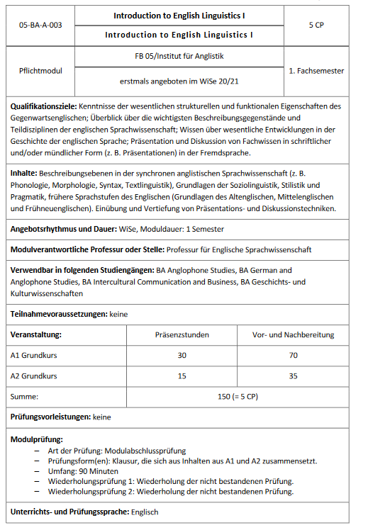
All you need to know about the “Modulbeschreibungen”
Courses for this Module in WiSe 20-21:
A1 Grundkurs → 6 groups to choose from:
Tuesdays, 10 a.m.-12 p.m. “Introduction to English Linguistics” with Dr. Güldenring
Tuesdays, 12-2 p.m. “Introduction to English Linguistics” with Dr. Güldenring
Wednesdays, 10 a.m.-12 p.m. “Introduction to English Linguistics” with Dr. Güldenring
Thursdays, 10 a.m.-12 p.m. “Introduction to English Linguistics” with Dr. Güldenring
Thursdays, 12-2 p.m. “Introduction to English Linguistics” with Dr. Güldenring
Thursdays, 2-4 p.m. “Introduction to English Linguistics” with Dr. Bernaisch
A2 Vorlesung → 2 (one-hour) lectures to choose from:
Tuesdays, 2-3 p.m. “History of the English Language” with Dr. Güldenring
Thursdays, 3-4 p.m. “History of the English Language” with Dr. Güldenring
MAP → 90 min. “Klausur” (testing content from both A1 GK and A2 VL) = 100% of the module grade

Slide 10
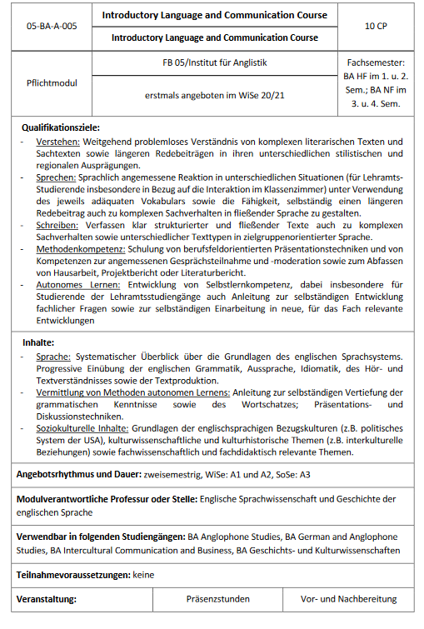
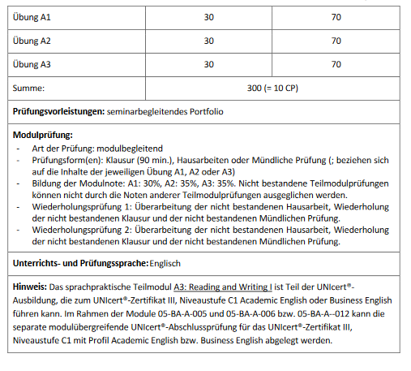
All you need to know about the “Modulbeschreibungen”
Courses for this Module in WiSe 20-21:
Let‘s check them out on the eVV!!!

Slide 11
Helpful Aids
eVV: https://www.uni-giessen.de/studium/studinfo/evv
Function: An overview of all courses offered / organized according to “Fachbereich”, Department, Study Program, Module Code
Flexnow: https://www.uni-giessen.de/studium/waehrend/ecampus/flexnow
Function: Course registration (= einflexen), de-registration (= ausflexen), grades
Stud.IP: https://studip.uni-giessen.de/
Function: An online platform for teaching and learning materials and activities

