Slide 1

Manual for general introduction and safety instructions

Slide 2
Instructions obligatory
All persons working in the iFZ must receive basic instructions before starting their work
For some areas, the responsible project manager must give specific instructions
The safety certification is valid for one year
Essential for ensuring good scientific practice

Slide 3
Secrecy
Persons working in the iFZ are sworn to secrecy with regard to facilities and activities in the iFZ
Information about laboratory or safety areas must not be communicated externally

Slide 4

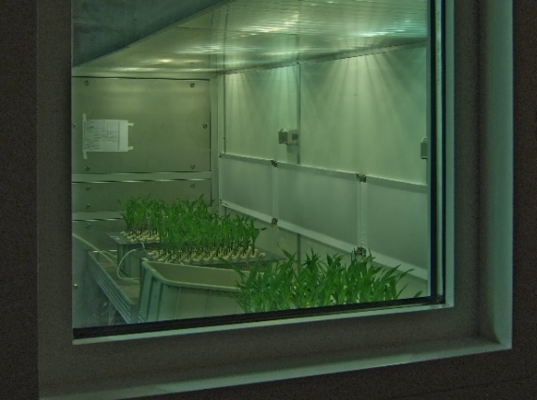
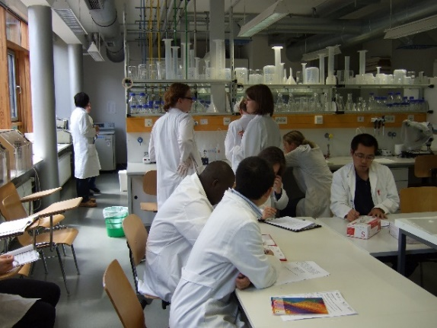
Secrecy
photographs inside iFZ buildings are only allowed with permission from the respective head of the area being photographed AND of any people who are photographed

Slide 5
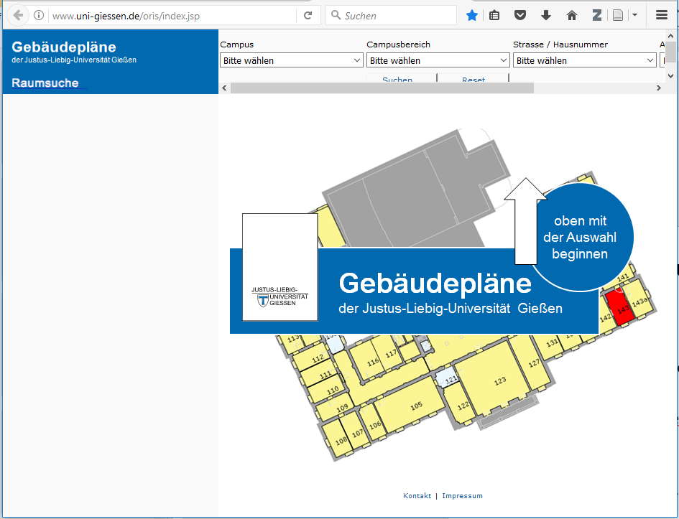
iFZ room denominations
B Office
L Lab
M Multifunctional
U Underground
H separate buildings

Slide 6
iFZ room access
Which room | Who decides about access
Room belonging to a professorship | Professor
iFZ common facility | Managers of iFZ common facilities
Technical facility | JLU administration

Slide 7
iFZ key system
Your digital key card is either a personalized staff card („Mitarbeiterkarte“), a student card or a non-individualized key card („Gastkarte“).
Key cards must be activated daily, before entering the building.

Slide 8
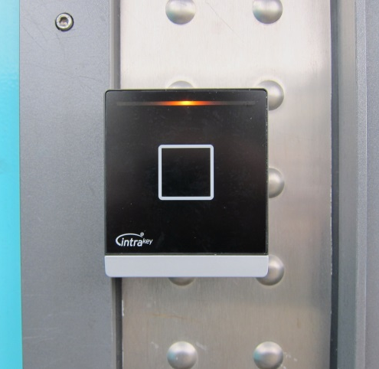
Opening iFZ doors
Activate card daily before entering the iFZ building (activation lasts until 24:00)
Press card onto activator at iFZ entrances for 2-3 seconds. The
first beep indicates start of reading, the
second beep indicates onset of access code writing, the third beep indicates the completion of the activation process.
If the card is removed before the third beep, the programming is incomplete and must be repeated for successful activation.

Slide 9
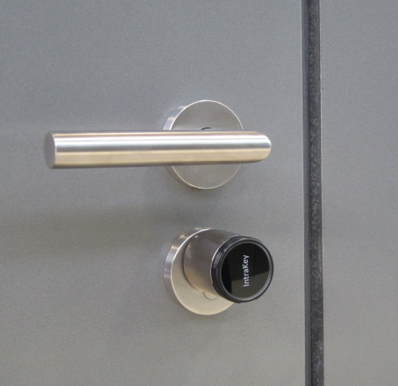
Opening iFZ doors
Room access
Hold key card close to the front of the lock cylinder below the door handle. The lock flashes a green light as soon as access is provided.
Turn lock to open like a mechanical key.
Lock the doors by the same routine.
An alarm beep after opening indicates a low lock battery - please notify the „Hausmeister“ (room/email?) so that he can replace the battery

Slide 10
Safety|Security Zones
Strangers are not permitted to enter the iFZ with you through the controlled doors.
Never work alone in iFZ laboratories and facilities outside of office hours.
Contractors and JLU service members must contact persons in charge daily BEFORE onset of work.
Always follow the safety directives of your responsible project manager or person in charge.

Slide 11
JLU Governing Bodies „Gremien“
Präsidium
Hochschulrat
Senat
Erweiterter Senat
Erweitertes Präsidium
Fachbereichsräte
Dekanate
JLU Administration
Präsidialbüro
Kanzlerbüro
Stabsabteilungen (StP, StF, StL, StW, AAA, BfC, und WTT)
Zentrale Studienberatung und Studierenden-Hotline
Dezernate (Dezernat B, Dezernat C, Dezernat D, Dezernat E)
www.uni-giessen.de/org

Slide 12
Responsibilities
JLU: President
Faculty: dean
Department: institute director
Professorship: professor
Central facility (e.g. greenhouses): head of central facility
Genetic engineering unit: UGI project leader

Slide 13
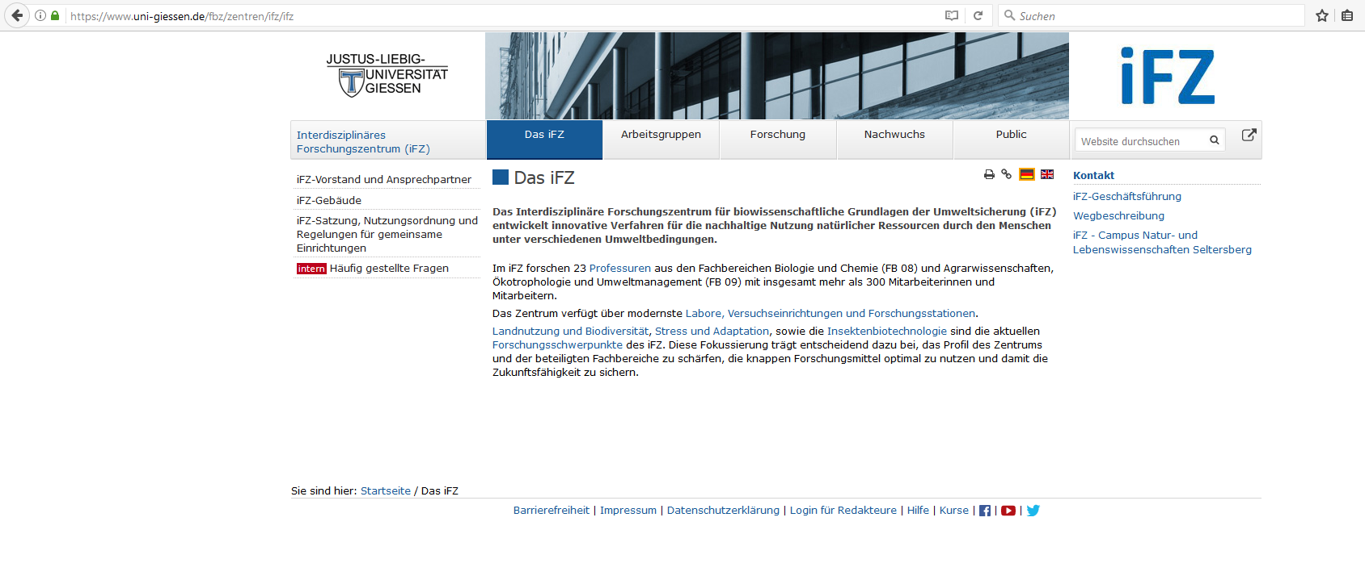
iFZ statutes and regulations
[official version available in German only]

Slide 14
Lab Rules
Eating, drinking and storage of food is absolutely prohibited in all laboratories.
Contractors, JLU technicians → Please use iFZ cafeteria
iFZ staff → please use iFZ social rooms (Wintergarten)
Please use cosmetics only in sanitary facilities, not in laboratories
When leaving laboratories you must disinfect and wash your hands.
Hand moisturiser is available in labs for use after washing.

Slide 15
Lab Rules
Lab coats are obligatory in all iFZ labs
Protective clothes must not be worn outside laboratories
Open shoes or bare feet are not permitted in laboratories
Avoid long scarfs, tie up long hair
Do not wedge or otherwise fix the fire protection doors to keep them open
Windows must remain closed at all times (to protect the environment outside and maintain the automated room ventilation)
Do not work in the lab with open wounds

Slide 16
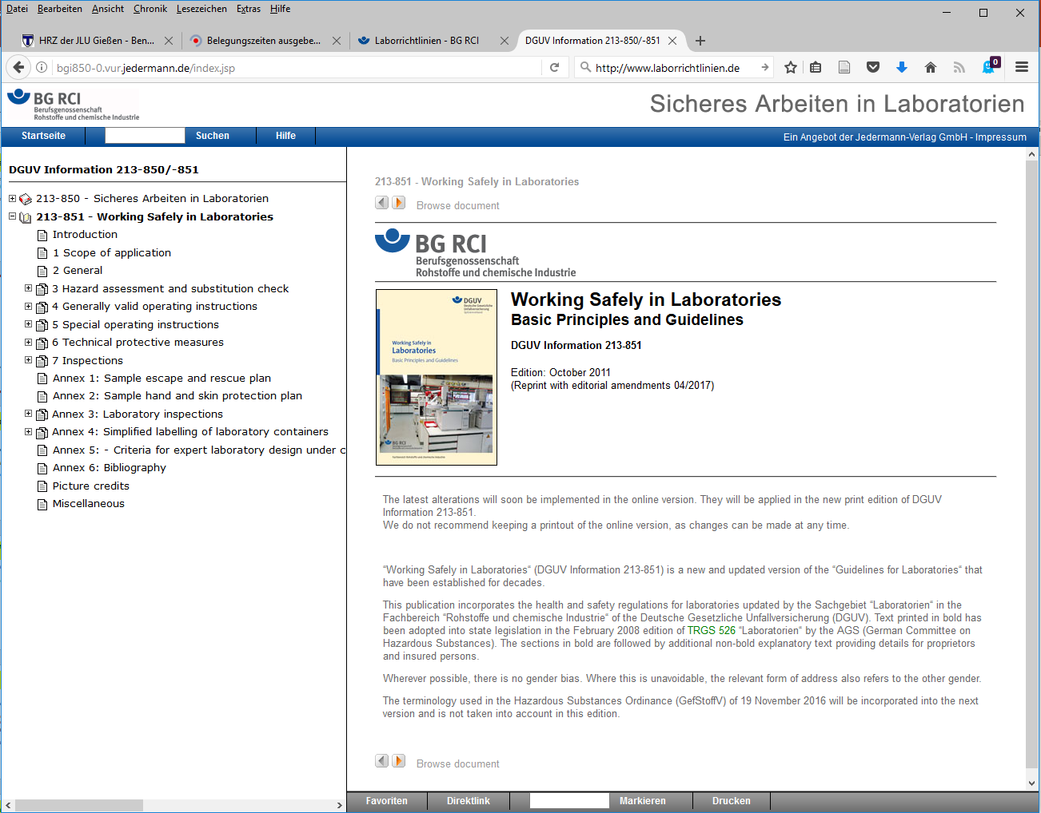

Slide 17
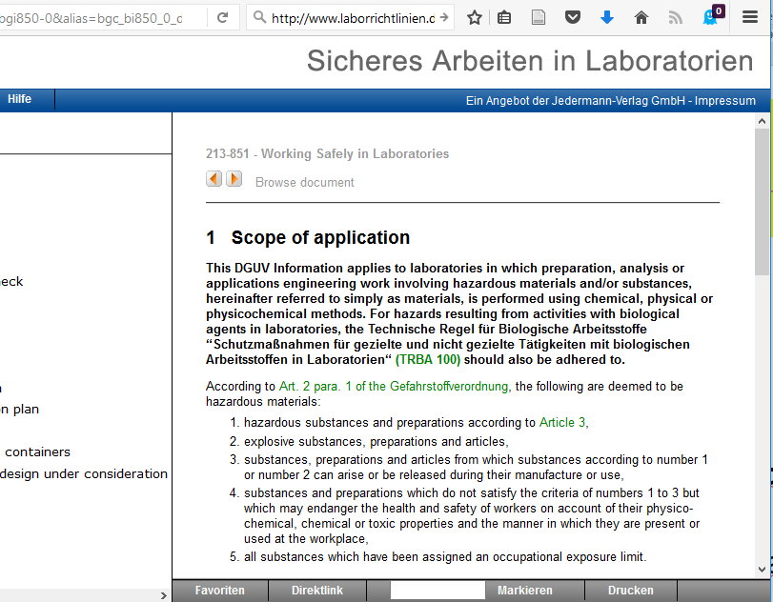

Slide 18
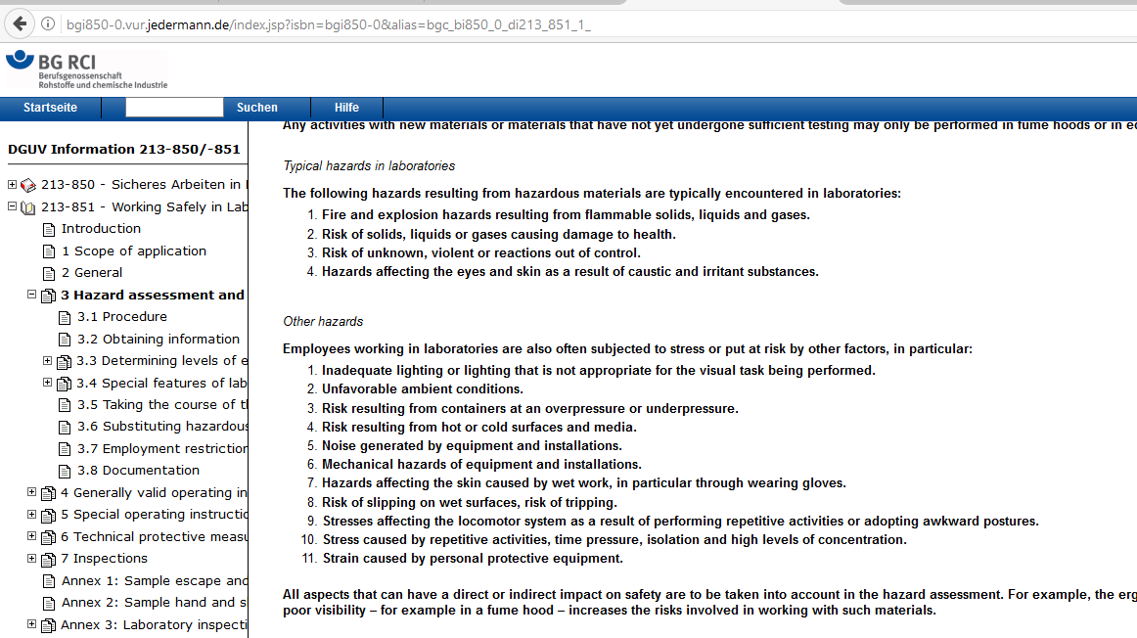

Slide 19
Risk levels for infectious agents and GMOs
Level | Risk to human health and environment | Spreading among human population | Prevention/ treatment
S1 | none | ---- | ----
S2 | low | improbable | possible
S3** | moderate NOT air-borne | rather unlikely | possible
S3 | moderate air-borne | possible | possible
S4 | high | pandemic! | NOT possible

Slide 20
Genetically Modified Organisms (GMO)
a GMO is an organism with a genome that has been modified in the laboratory.
GMO organisms do not occur naturally and in Germany their use is restricted to laboratories.
Examples:
Modified bacteria
Cells infected with modified bacteria or viruses
Modified plants or laboratory animals

Slide 21
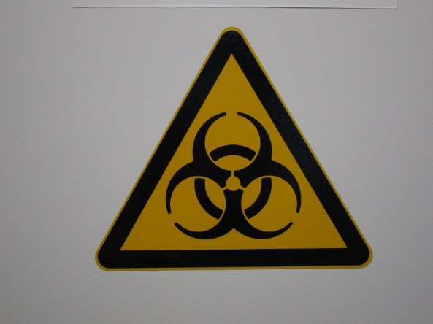
Biosafety
Protection of staff from hazards working with biological agents
Regulations
German Genetic Engineering Ordinance
(Gentechnikgesetz und GenTSV)
German Ordinance on Biological Agents
(Biostoffverordnung)
German Infectious Disease Control Act and
the Animal Pathogen Ordinance
Technical rules (e.g. TRBA 100 protective measures in laboratories)
Designated project managers are responsible for specific areas

Slide 22
iFZ Genetic Engineering Facilities
Gentechnische Anlage | Sich.stufe | UGI | Projektleiter | BBS
Institut für Mikro- und Molekularbiologie L251, Nutzung nur unter S1-Bedingungen | S1 | 80 | Prof. Dr. Gabriele Klug, Prof. Dr. Kai Thormann | Dr. S. Rahlfs
Institut für Mikro- und Molekularbiologie L230, L231, L232, L233, L234, L235, L236, L245, L246, L247/248, L249/L250, M233, M234, M235, M236, M237, M238, M239, M244, M245; L021; U170, U176 | S1 | 81 | Prof. Dr. Gabriele Klug, Prof. Dr. Kai Thormann | Dr. S. Rahlfs
Institute für Phytopathologie und Insektenbiotechnologie L335, L336, L337, L338, L347, L348, L350, L357, M328, M329, M330, M331, M336, M337, M338; M420, M423, L423, L431/432, L433, M422; L349, M421, M422a | S1 | 82 | Dr. Jens Steinbrenner | Dr. C. Obermeier
Institut für Pflanzenernährung L034-L036, L037, L038, L039, L040, L049, L050, L051, L052, L053, L054, L055, L056, M034, M035, M042, M043; L131, M129; U150 | S1 | 83 | Prof. Dr. Till Schäberle | Prof. Dr. U. Wenzel
Institut für Pflanzenbau und Pflanzenzüchtung I L320/321, L322, L323, L324, L325, L327, L332, L333, L334, M318, M319, M320, M321, M322, M323; L420, L421, L422 | S1 | 84 | Dr. Christian Obermeier | Dr. J. Imani
Institut für Angewandte Mikrobiologie L017; L 019 | S1 | 85 | Prof. Dr. Dr. Peter Kämpfer | Dr. Stefan Rahlfs
Institut für Pflanzenbau und Pflanzenzüchtung II Biometrie und Populationsgenetik L203, L204, L205, M212, M211 | S1 | 86 | Prof. Dr. Rod Snowdon | Dr. J. Imani
Biotechnikum mit Klimakammern H023, H031, H042, H024-H030, H035-H041,H012-H015, H017-H020, Flure H011, H021, Putzraum H032, Toiletten H033, H034; H004, H005, H006, H010 | S1 | 87 | Dr. Jens Steinbrenner | Dr. Stefan Rahlfs
Institut für Ernährungswissenschaft, Biochemie der Ernährung L147, L148, L151, L152, L153, M128, M136 | S1 | 88 | Prof. Dr. Jude Przyborski | Prof. Dr. U. Wenzel
iFZ-Gewächshausanlage K1 - K8, K9 - K15, Räume R1, R3, R4a, R5, R5a, Flur R6 | S1 | 89 | Dr. Jens Steinbrenner | Dr. Stefan Rahlfs
Forschungshalle IFZ, Kombination von Labor- und Gewächshausbereich | S1 | 90 | Dr. J. Imani | Dr. Stefan Rahlfs
Institut für Ernährungswissenschaft, Biochemie der Ernährung: L149, L150 | S2 | 91 | Prof. Dr. Jude Przyborski | Prof. Dr. U. Wenzel
Professur für Molekulare Ernährungsforschung L306, L307, L308, L318 | S1 | 92 | Prof. Dr. Uwe Wenzel | Dr. Stefan Rahlfs
Institut für Phytopathologie (Praktikumslabor) U144, U152 | S1 | 93 | Dr. Jafargholi Imani | Dr. Stefan Rahlfs
Institut für Tierernährung und Ernährungsphysiologie L116/L116a, L117, L118, L119, M118, M120, M129 | S1 | 94 | Dr. Gaiping Wen | Prof. Dr. U. Wenzel
Institut für Tierernährung und Ernährungsphysiologie, Stoffwechsellabor Räume 11, 12, 13, 15/17 | S1 | 95 | Dr. Gaiping Wen | Prof. Dr. U. Wenzel
Institut für Ernährungswissenschaft, Lebensmittelwissenschaft L132, L133 | S1 | 96 | Dr. Gaiping Wen | Dr. Stefan Rahlfs
Institut für Insektenbiotechnologie L352, L353, L355, L439, M422a, M428, M429 und M430 | S1 | 97 | Dr. Kwang-Zin Lee | Dr. W. Wende

Slide 23
CVH Genetic Engineering Facilities
Gentechnische Anlage | Sich.stufe | UGI | Projektleiter | BBS
Professur für Immunologie, Praktikumsbereich CVH Räume 2.03, 2.10, 2.11, 4.02 | S1 | 134 | PD Dr. Rolf Ross | Dr. Wolfgang Wende
Institut für Botanik, Prof. Spezielle Botanik CVH Räume 027, 028, 030 | S1 | 138 | Prof. Dr. Birgit Gemeinholzer | PD Dr. M. Zeidler
Institut für Tierphysiologie CVH Räume 3.16, 3.17, 3.18, 3.19, 3.20, 3.21, 3.22, 3.23, 3.24 und 3.47 | S1 | 166 | Prof. Dr. Ivan Manzini | Prof. Dr. A. Dorresteijn
Institut für Botanik, Prof. Evol. Entwicklungsbiologie der Pflanzen CVH Räume -1.22, 0.11a, 0.11b, 0.12, 0.13, 0.14, 0.15a, 0.15b, 0.15c, 0.15d, 0.16a, 0.16b | S1 | 167 | Prof. Dr. Annette Becker | PD Dr. M. Zeidler
Prof. Zoologie mit Schwerpunkt Molekulare Entwicklungsbiologie CVH Räume 1.14a, 1.14b, 1.15, 1.16, 1.17 | S1 | 199 | Prof. Dr. Nikola-Michael Prpic-Schäper | Prof. Dr. Annette Becker

Slide 24
Genetic Engineering – cultures
All cultures (including GMOs) must be labelled with:
- date
- identification/organism
- owner
All cultures must be stored within designated areas.
Any unlabelled viable materials must be treated as potential GMOs and handled in accordance with these conditions.
Notify the lab manager immediately, if you find unlabelled materials.

Slide 25
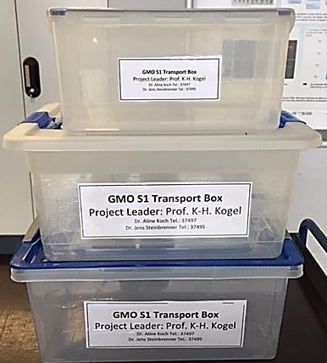
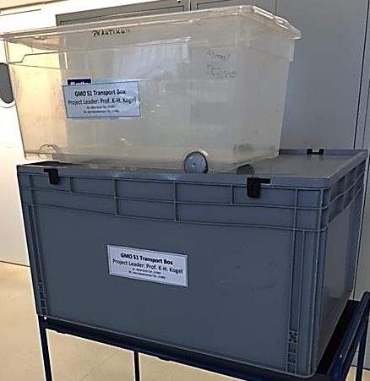
Genetic Engineering – Transport
GMOs must always be transported in closed, labeled containers.

Slide 26
Genetic Engineering – Waste
All waste contaminated with GMOs must be autoclaved.
  Waste:
  All solid and liquid waste contaminated with GMOs
  Plant material (all propagative parts)
  Potting soil
The autoclave must only be used by trained personnel.
Decontamination of GMOs must be documented.
After autoclaving, the waste can be disposed in a normal manner.

Slide 27
Genetic Engineering – Disinfection/Decontamination
If GMOs are spilled on the bench, floor etc :
  remove material with paper towels,
  autoclave waste,
  disinfect the area with Frekanol.
If GMOs are spilled on skin: disinfect with Sterillium!
Always inform the responsible project leader!
For details on desinfection of skin, (bench) surfaces, devices: see the safety directive ("Betriebsanweisung") in each lab.

Slide 28
Biological Safety - “Formblatt Aufzeichnungen”
The idea of “Formblatt Aufzeichnungen” is, that the assembly/construction/features of GMOs in use
(incl. vectors and procedures) must always be traceable.
“Formblatt Aufzeichnungen” are fixed in each lab journal.
The lab journal does not leave the institute.

Slide 29
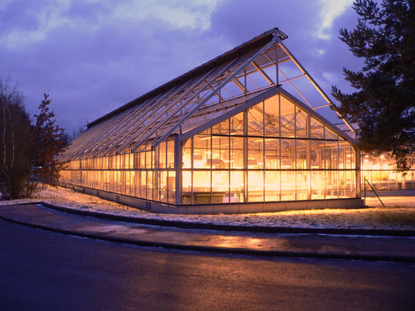
iFZ GMO plant growth facilities
Because of the different locations there are several INDEPENDENT biological containment facilities associated with the iFZ
  Dr. Jafargholi Imani
    UGI 90 iFZ Forschungshalle
  Dr. Jens Steinbrenner
    UGI 89 iFZ Greenhouse
  Dr. Jens Steinbrenner
    UGI 87 iFZ Biotechnikum Growth Chambers

Slide 30
General rules
New users must undergo a safety briefing (by an authorised project leader) before start of work and must read the appropriate manual of operations (“Betriebsanweisung”).
For each facility there is a specific, detailed manual of operations.
Annual repetition of safety briefings is obligatory.
The project leader (“Projektleiter”) responsible for GMO work in each facility
  must be informed before start of work (new cultures: S1?)
  must be provided with a documentation of all GMOs (he/she needs a complete list of GMO species in the facility for the annual re-evaluation of S1 level classification)
  Simplified documentation is possible for e.g. propagation of GMOs documented in other JLU Giessen GMO labs (UGIxx)
  (ask project leader for detailed instructions)

Slide 31
General rules for biological containment facilities
ALL new users must visit the JLU medical officer („Betriebsarzt“) when assuming work in a biological containment facility
Repeat medical checks are required every 3 years (to be recorded by responsible project leader)
Always keep doors closes if GMOs are present
Record all experiments with GM plants (owner, GMO type, objective, end of experiment/transportation into UGIxx):
list at cabin front doors, books in chambers
Label all plants and samples fully and non-ambigiously!
Lab coats are mandatory in biological containment facilities!
Only transport GMOs in closed, unbreakable, labeled boxes
Transport of flowering plants is not permitted!
Inactivate GMO material in autoclave
Control of pests/pathogens is mandatory
Eating, drinking, smoking or storage of food is absolutely prohibited in all biological containment facilities (S1/S2 areas, including corridors).

Slide 32
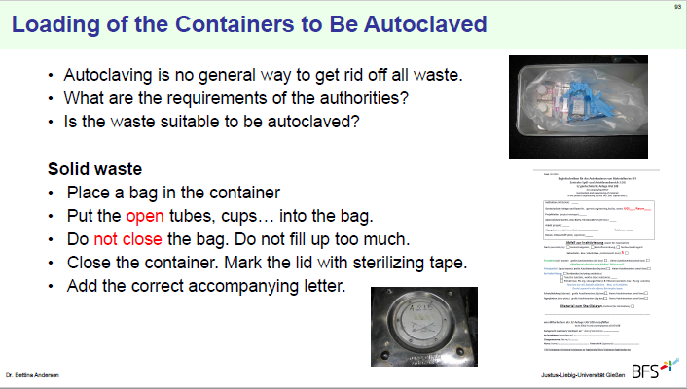
Waste Management

Slide 33
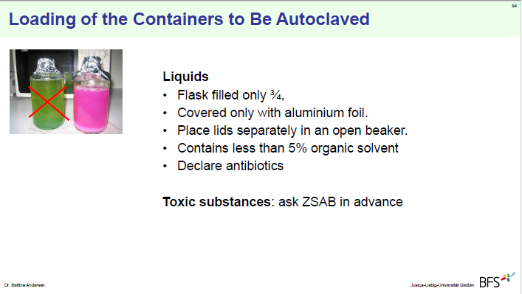
Waste Management

Slide 34
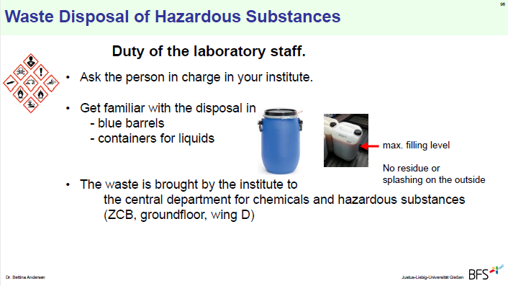
Waste Management

Slide 35
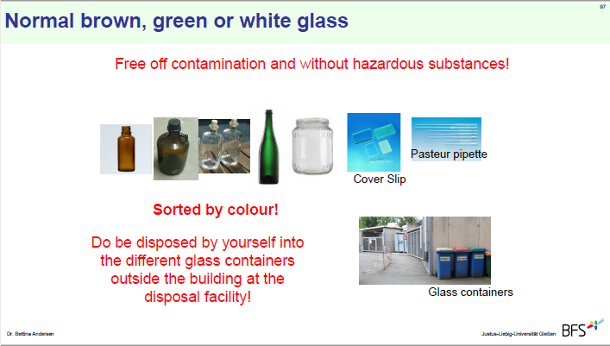
Waste Management

Slide 36
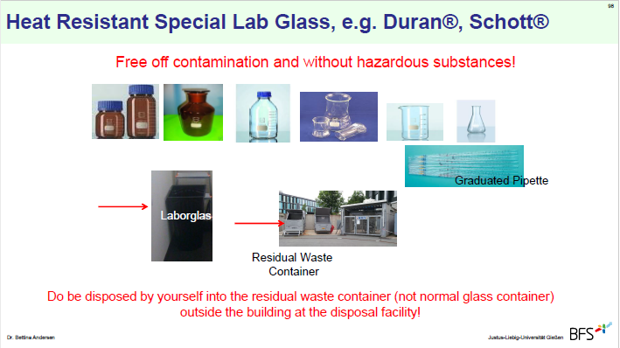
Waste Management

Slide 37
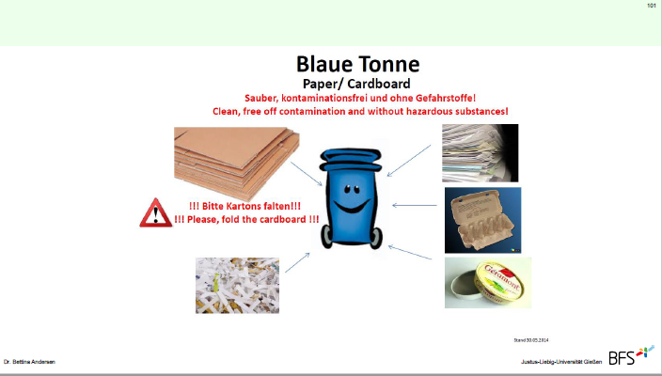
Waste Management

Slide 38
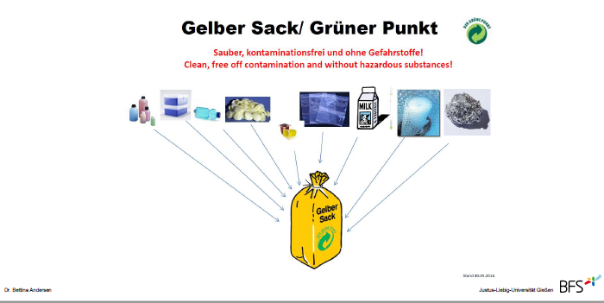
Waste Management

Slide 39
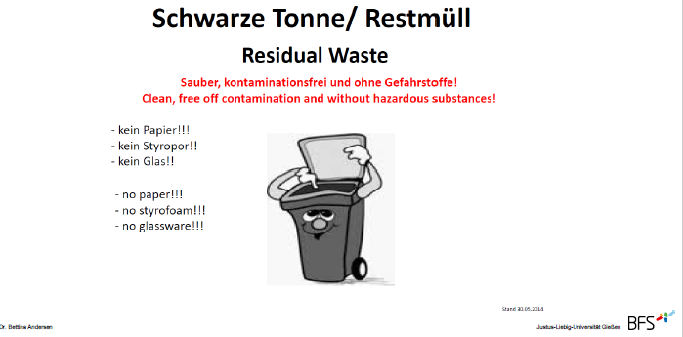
Waste Management

Slide 40
Tasks of cleaning staff
Cleaning of the hand washbasin
Cleaning of the floor
(contaminations must be removed by the scientific staff before cleaning)
Emptying of the trash bins (household garbage)
NO disposal of hazardous waste

Slide 41
Maintenance in research areas
During maintenance work, laboratory work with potential hazards is prohibited.
Only laboratory staff are permitted to open fridges, freezers and incubators.
Maintenance staff may ot touch laboratory equipment without the consent of laboratory staff.
Special protective clothing (coats or gloves) provided to maintenace staff must remain in the work area and must not be worn in the corridors.

Slide 42
In case of a lab accident
keep calm –
think first ?
then act !

Slide 43
In case of a lab accident
Identify the danger
Determine and prevent personal risk
Then warn other staff

Slide 44
In case of a lab accident
Block and contain:
Avoid spreading contamination (such as GMOs, infectious agents, chemical hazards) onto door handles, telephone receivers, transportation containers, etc.
Immediately contact the person responsible for the facility or your safety officer
Serious incidents: clearance only after consulting JLU Safety Department

Slide 45
Emergency Numbers
In case of a medical emergency, call
112 FIRST AID
In case of a fire, call
112 FIRE BRIGADE
In case of technical emergency 24/7 call 0641 - 99 - 12666 (JLU phone 12666)
In case of a crime, call 110 POLICE

Slide 46
Emergency Calls
If available, use your mobile phone to be able to keep contact with the emergency team while moving inside or outside the building.
Emergency calls are possible from all iFZ telephones.
Emergency calls [in Gießen] are possible in both German and English.
Tell the emergency/ambulance coordinator:
“Pickup at Lieferanteneingang, the main entrance at the turnaround”
Instruct someone to meet the ambulance at the main entrance.
Tell the emergency team: JLU insurance “Unfallkasse Hessen”

Slide 47
JLU Work-Health-Environment Management System (AGUM)
AGUM-Notfall-Organisation (in German)
www.uni-giessen.de/org/admin/dez/b/3/agum/notfallorga
under construction

Slide 48
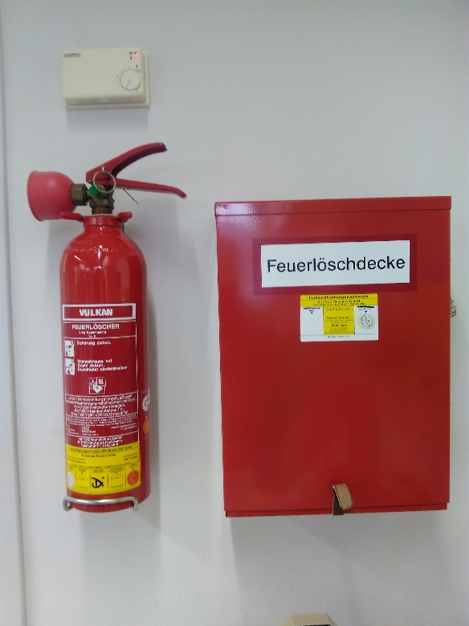
In case of fire
Try to extinguish the fire
TAKE NOTE!
Where is the firefighting equipment located? (fire extinguisher, fire blankets)
How to use the firefighting equipment?

Slide 49
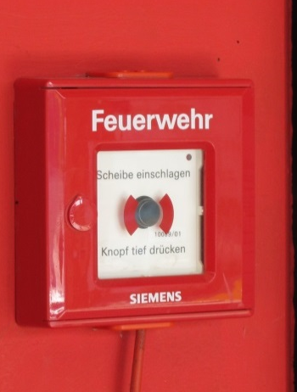
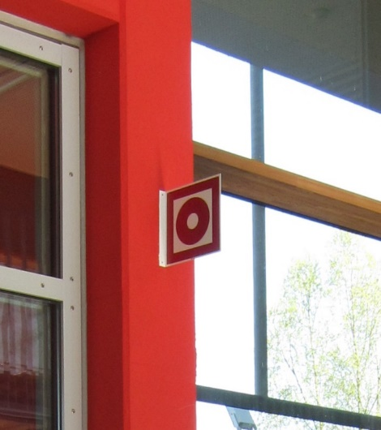
Raising a fire alarm
TAKE NOTE!
Become acquainted with the position of the push-button fire alarms

Slide 50
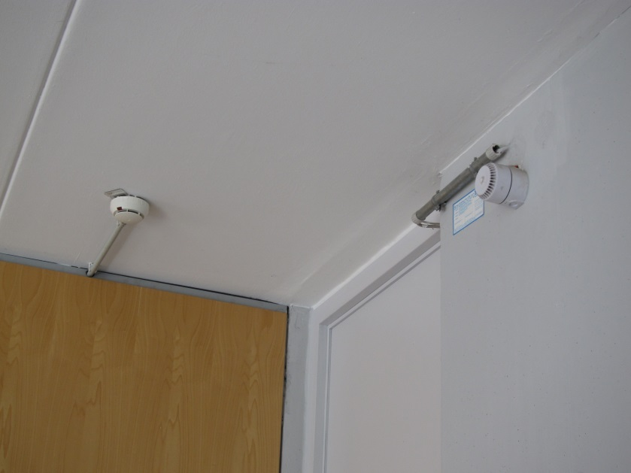
Automatic Fire Alarm
Smoke (or welding) triggers the automatic fire detectors on the ceiling
In this case the fire alarm starts automatically and the fire department is contacted automatically

Slide 51
Hearing an alarm
keep calm –
think first ?
then act !

Slide 52
Hearing an alarm
Bring yourself to safety
Assist handicapped persons
Consider securing your workplace, if still possible
Leave the building immediately!
Follow escape routes
Do NOT use an elevator! You risk suffocating!

Slide 53
What to do before evacuation
If time permits, secure your workplace (e.g. close bottles with hazardous substances, close fume hoods, extinguish open fire)
Only use the emergency stop for gas or electricity in case of acute hazard (e.g. fire IN the respective lab)
Unnecessary use of the emergency stop for gas or electricity can lead to additional hazards for yourself and for the emergency personnel!

Slide 54
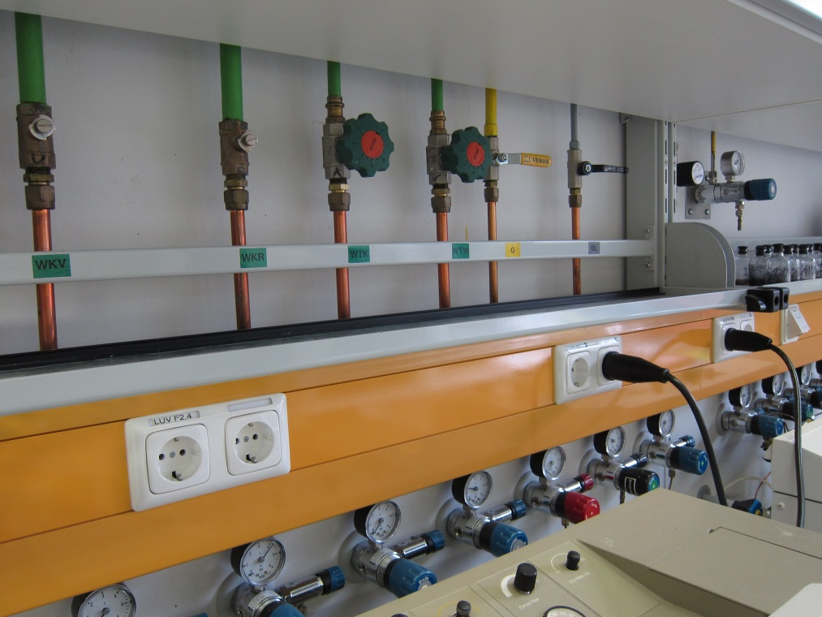
Technical Emergency: Water and Gas
Shut-off valves are located under top cupboard

Slide 55
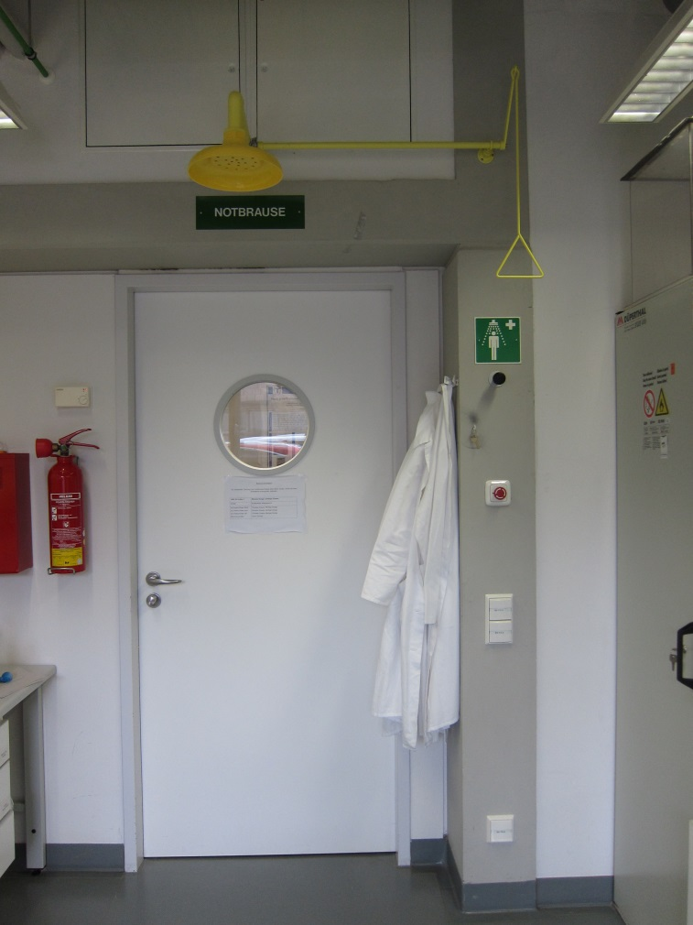
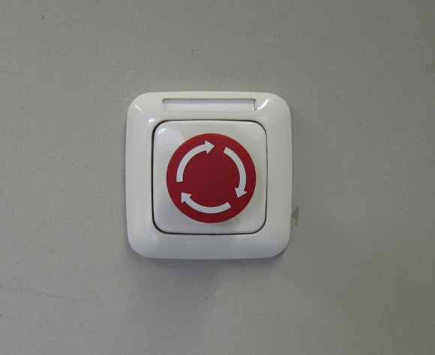
Technical Emergency: Electricity
Emergency button
Inside the lab,
close to the door

Slide 56
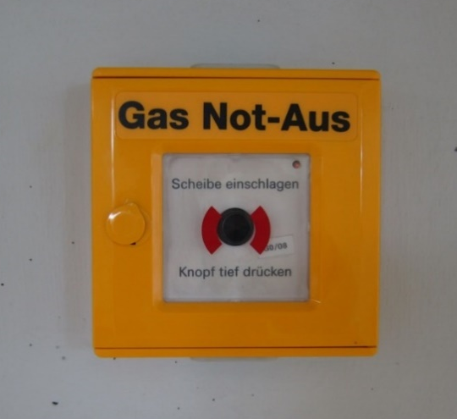
Technical Emergency: Gas
Emergency buttons to shut down gas supply
are located in the corridor
[use any tool to break the glass;
do not use hand or ellbow,
serious risk of injury]
The button switches off
central gases and gases inside gas safety cabinets
In the entire respective part of the building (C, D, E or F)
Emergency buttons can only be reset by JLU technical worhshop staff (Bereichswerkstatt)

Slide 57

Emergency body showers in labs
Emergency body shower
located at all laboratory doors
To use the emergency body shower pull down the handle,
to close push the handle upwards.
There is no floor drain installed in iFZ labs.
The water released must be removed manually – see the person in charge of the lab.

Slide 58
Eye showers in labs
Eye shower at the wash basin - pull out!
Changing rooms and showers are available in the basement (U1) (stairway opposite the main entrance / „Poststelle“)

Slide 59
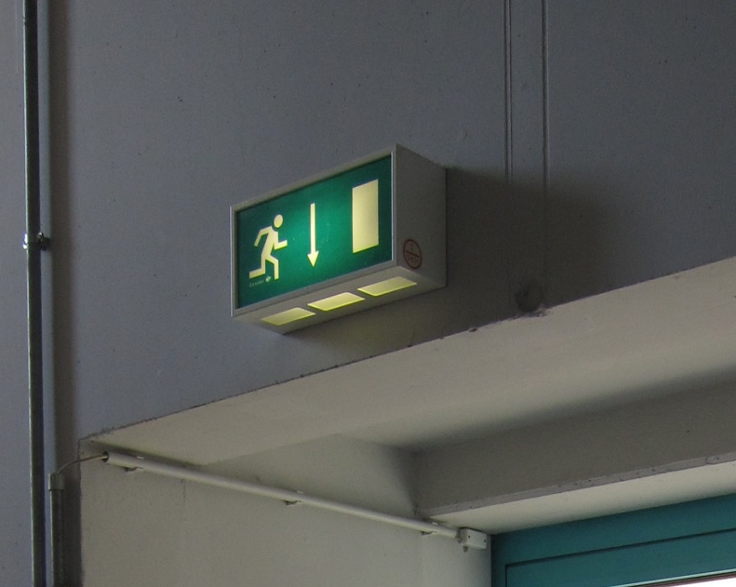
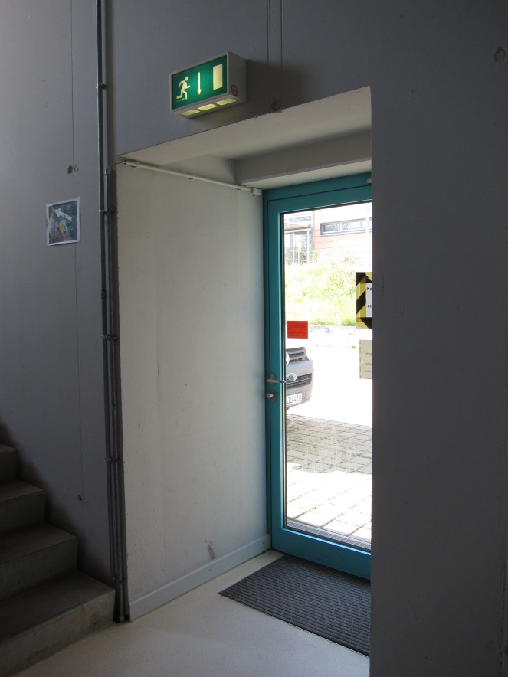
Escape Routes
Access must never be blocked

Slide 60
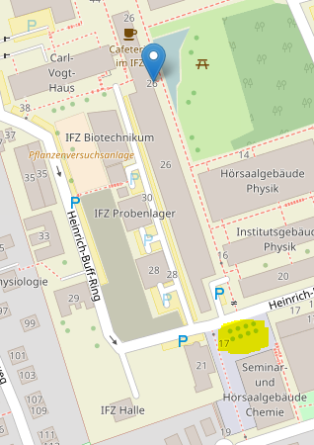
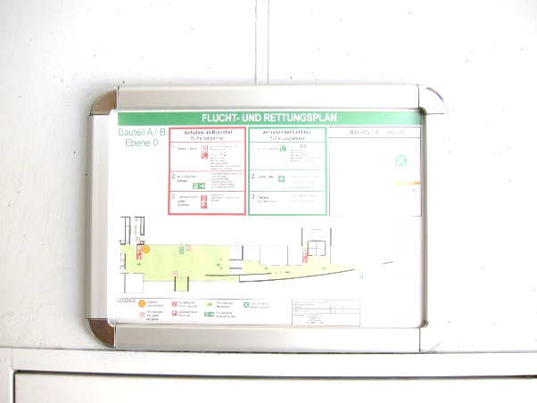
Escape and Rescue Plan
iFZ meeting point for all iFZ groups:
Courtyard of new chemistry building (Vorplatz Neue Chemie)

Slide 61

At the Meeting Point
Each team (institute/professorship)
gathers at the Meeting Point
Check: anyone missing?
PRACTICE:
Where is our meeting point?
How do we check if anyone is missing?

Slide 62
Re-entering the iFZ
NEVER re-enter the building when the emergency alarm is sounding
Permission to re-enter the buildiung is granted EXCLUSIVELY by the fire department, the JLU safety department or persons authorized by either of these

Slide 63
First Aid
Stop working immediately
Apply appropriate first aid procedures
Call emergency, if necessary, – if not
Visit „Durchgangsarzt“ (physician in charge for JLU members) for treatment and formal diagnosis
Immediately notify all persons responsible for lab/facility
Injuries without a follow-up visit to the medical doctor have to be documented in the accident block („Unfallblock“) of the respective JLU unit

Slide 64
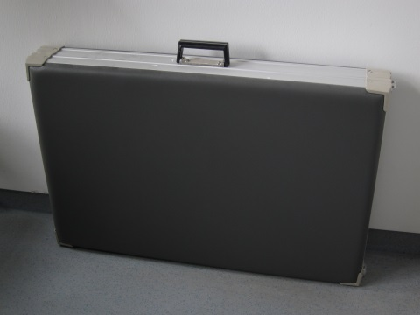
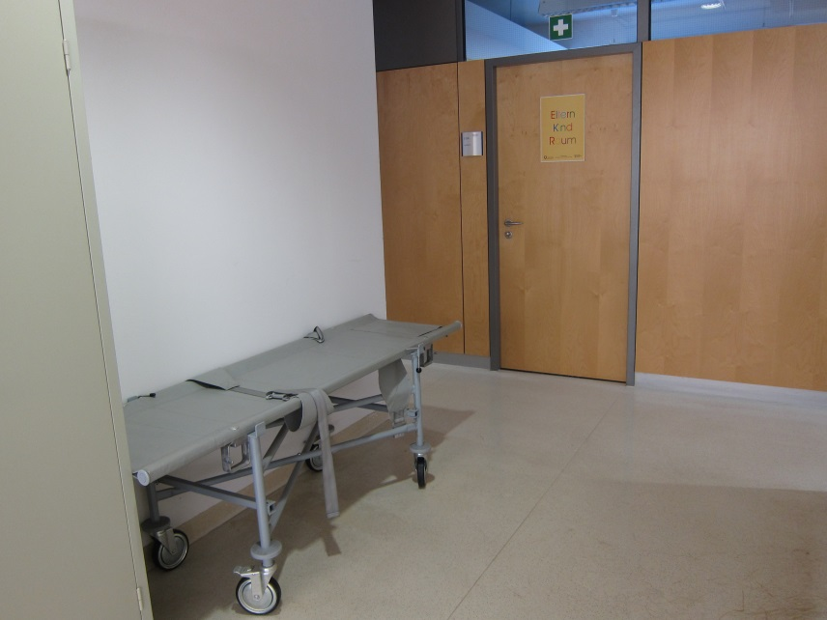
First Aid Stretchers
iFZ ground floor:
Mobile stretcher outside B004
Portable fold-up stretcher
inside B003
[where else close
to your institute??]

Slide 65

First Aid Kits
First aid kits
are indicated by a white cross on a green background
Emergency information:
Emergency calls numbers,
names of first-aid responders and locations of portable medical units can be found at institute displays

Slide 66
Report after incident to
iFZ staff:
Professor
Project leader of S1 / S2 area or isotope lab
iFZ management Tel. 17500
JLU administration / HRZ staff:
Supervisor
Contractor staff:
Contact person at JLU

