Slide 1
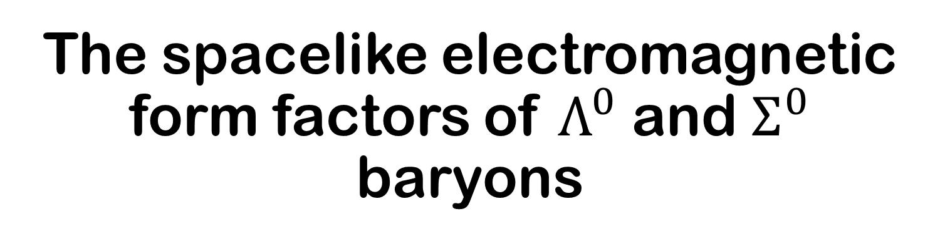
The spacelike electromagnetic form factors of $Λ^{0}$ and $Σ^{0}$ baryons
Langtian Liu
Giessen University

Slide 2
Outline
Electromagnetic form factors
Methods
Calculation ingredients
Results
Conclusion and outlooks

Slide 3
Electromagnetic form factors

Slide 4
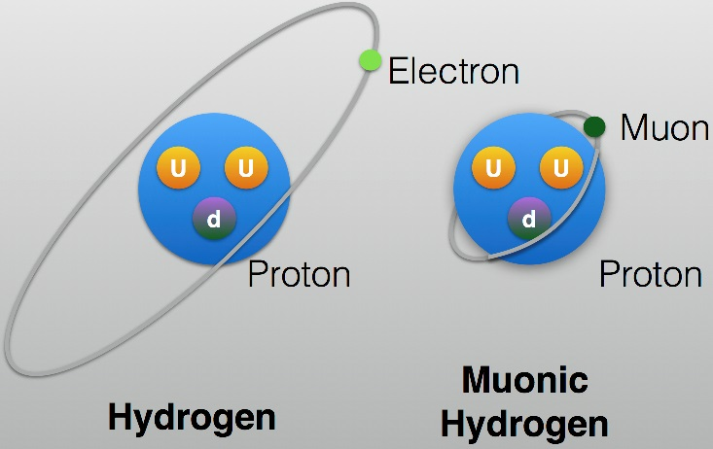
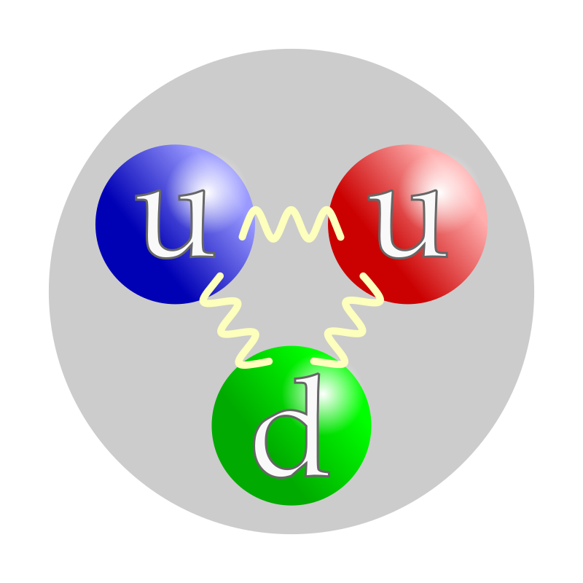

Some ways to study composite systems
Replace the ingredients
s,c quark
Muon hydrogen
u,d quark

Slide 5
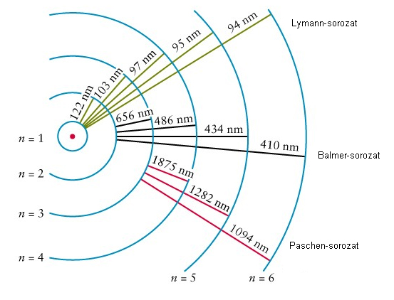
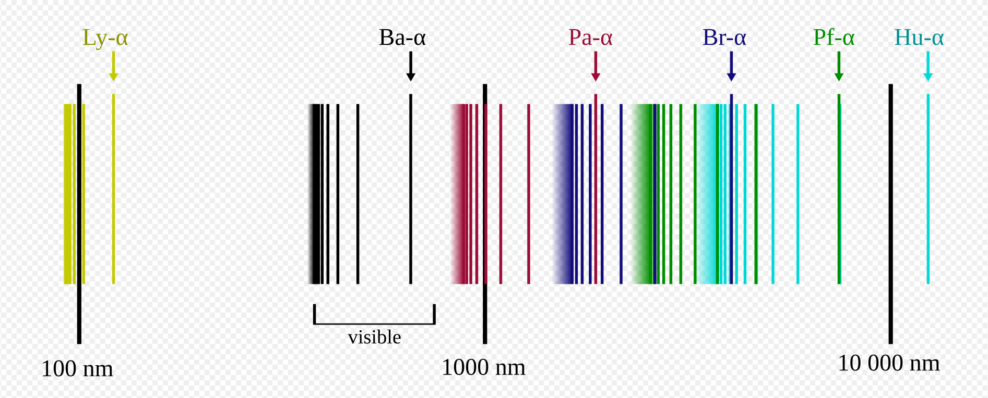
Some ways to study composite systems
Excite them
The quantum mechanics appeared.

Slide 6
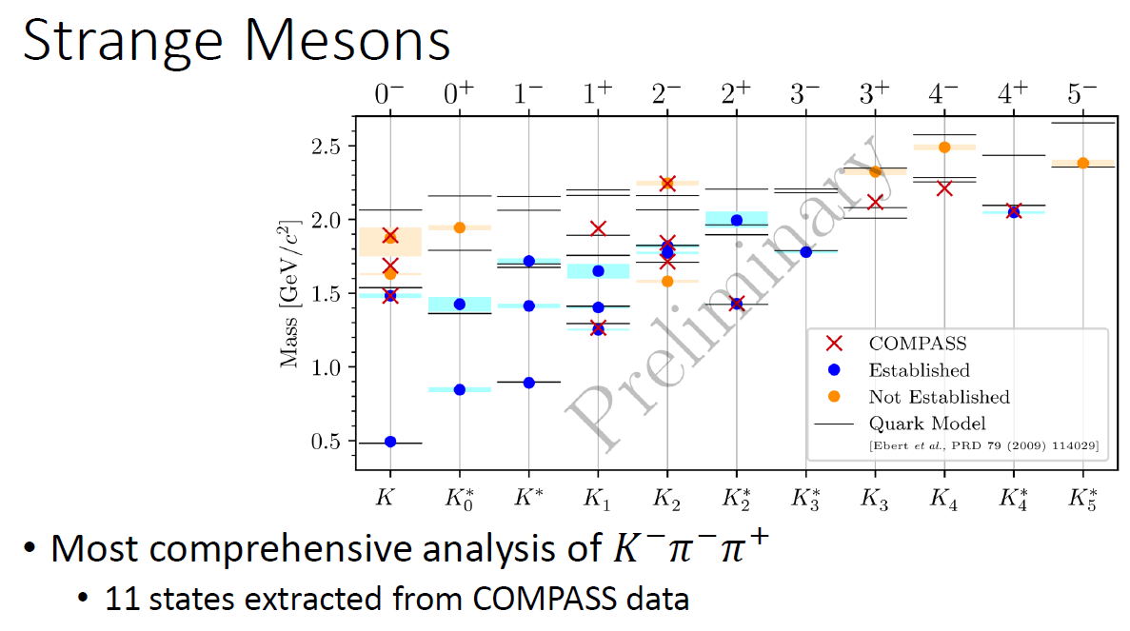
Some ways to study composite systems
Excite them (for QCD) --- meson spectrum
https://indico.cern.ch/event/1367212/contributions/5839786/

Slide 7
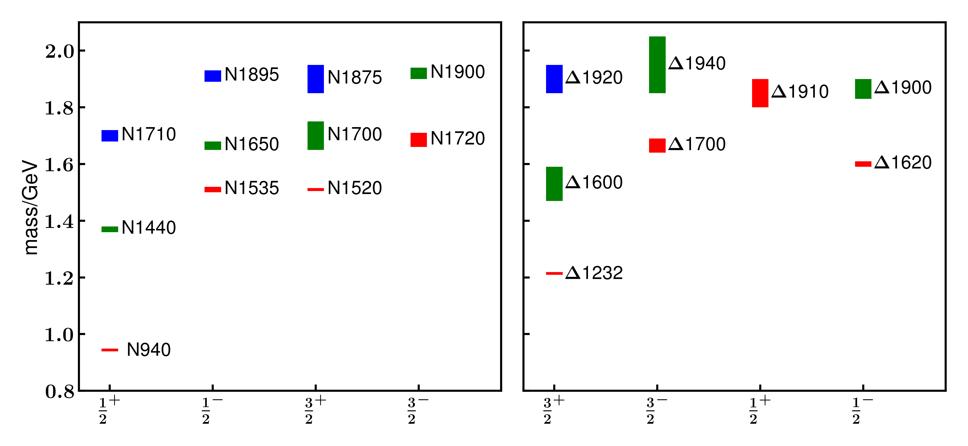
Some ways to study composite systems
Excite them (for QCD) --- baryon spectrum

Slide 8
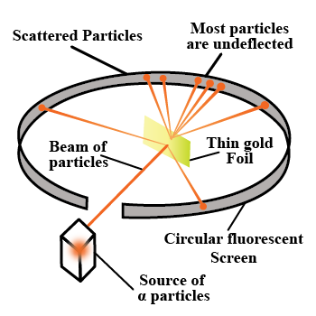
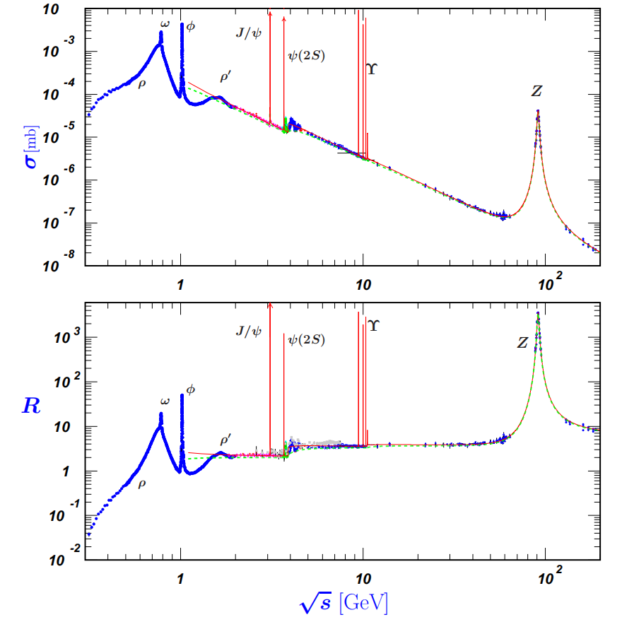
Some ways to study composite systems
Scatter --- cross section is the only physical observable in high energy physics
Rutherford α scattering
R ratio of cross sections

Slide 9
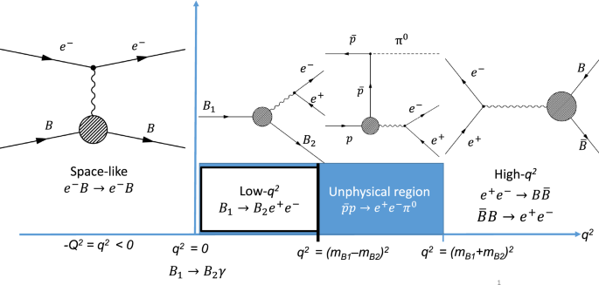
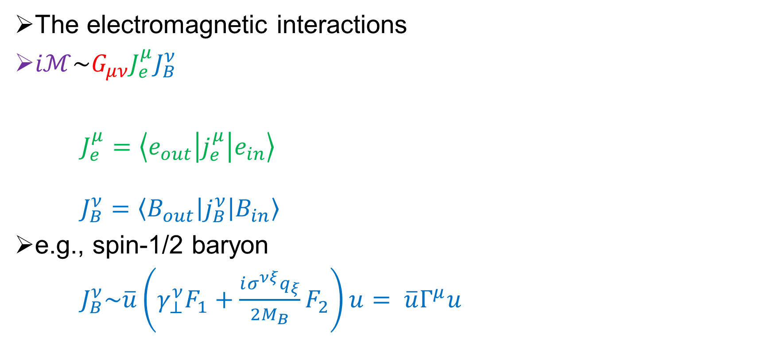
Electromagnetic form factors
The electromagnetic interactions
$iℳ\sim G_{μν}J_{e}^{μ}J_{B}^{ν}$
$J_{e}^{μ}=\left\langle e_{out} | j_{e}^{μ} | e_{in}\right\rangle$
$J_{B}^{ν}=\left\langle B_{out} | j_{B}^{ν} | B_{in}\right\rangle$
e.g., spin-1/2 baryon
$J_{B}^{ν}\sim \overline{u}\left(γ_{⊥}^{ν}F_{1}+\frac{iσ^{νξ}q_{ξ}}{2M_{B}}F_{2}\right)u= \overline{u}Γ^{μ}u$
PANDA Phase One. Eur. Phys. J. A 57, 184 (2021)

Slide 10
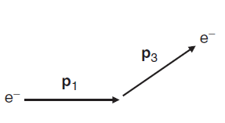
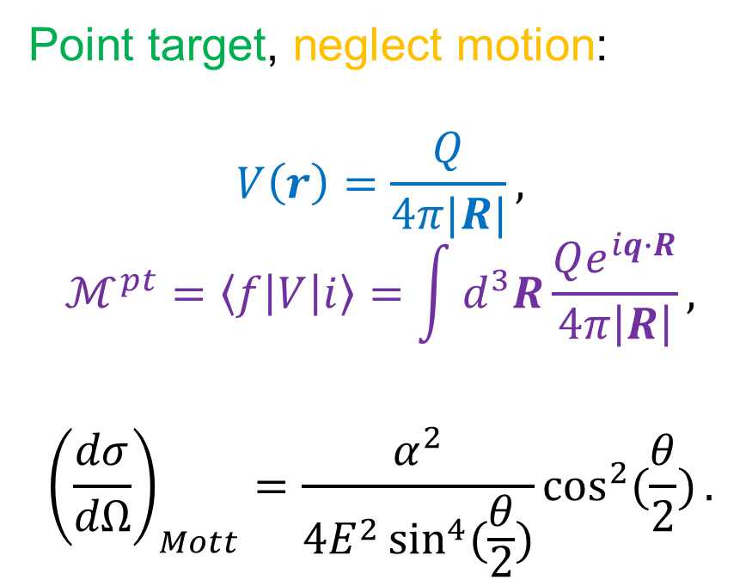
Electromagnetic form factors
Form factors ~ Accumulated phase difference
Point target, neglect motion:
$$V\left(r\right)=\frac{Q}{4π|R|},$$
$$ℳ^{pt}=\left\langle f | V | i\right\rangle =\int{d^{3}R}\frac{Qe^{iq∙R}}{4π\left|R\right|},$$
$${\left(\frac{dσ}{dΩ}\right)}_{Mott}=\frac{α^{2}}{4E^{2}\sin^{4}{(\frac{θ}{2})}}\cos^{2}{(\frac{θ}{2})}.$$
Scatter off point particle

Slide 11
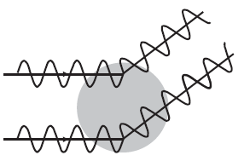
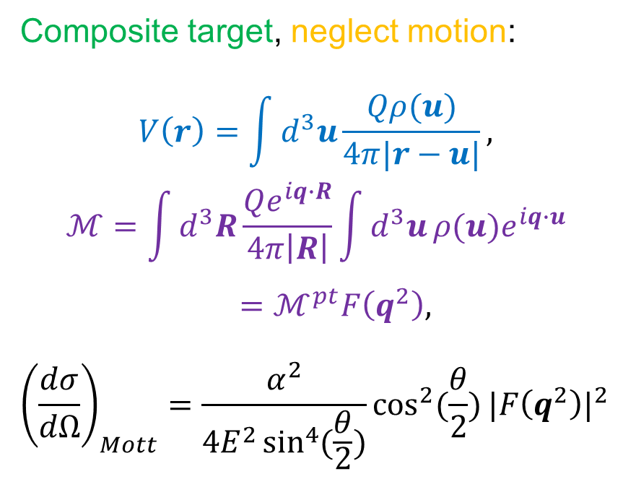
Electromagnetic form factors
Form factors ~ Accumulated phase difference
Composite target, neglect motion:
$$V\left(r\right)=\int{d^{3}u}\frac{Qρ(u)}{4π|r−u|},$$
$$ℳ=\int{d^{3}R}\frac{Qe^{iq∙R}}{4π\left|R\right|}\int{d^{3}u}ρ(u)e^{iq∙u}$$
$=ℳ^{pt}F\left(q^{2}\right),$
$${\left(\frac{dσ}{dΩ}\right)}_{Mott}=\frac{α^{2}}{4E^{2}\sin^{4}{(\frac{θ}{2})}}\cos^{2}{(\frac{θ}{2})}{|F\left(q^{2}\right)|}^{2}$$
Scatter off composite particle

Slide 12
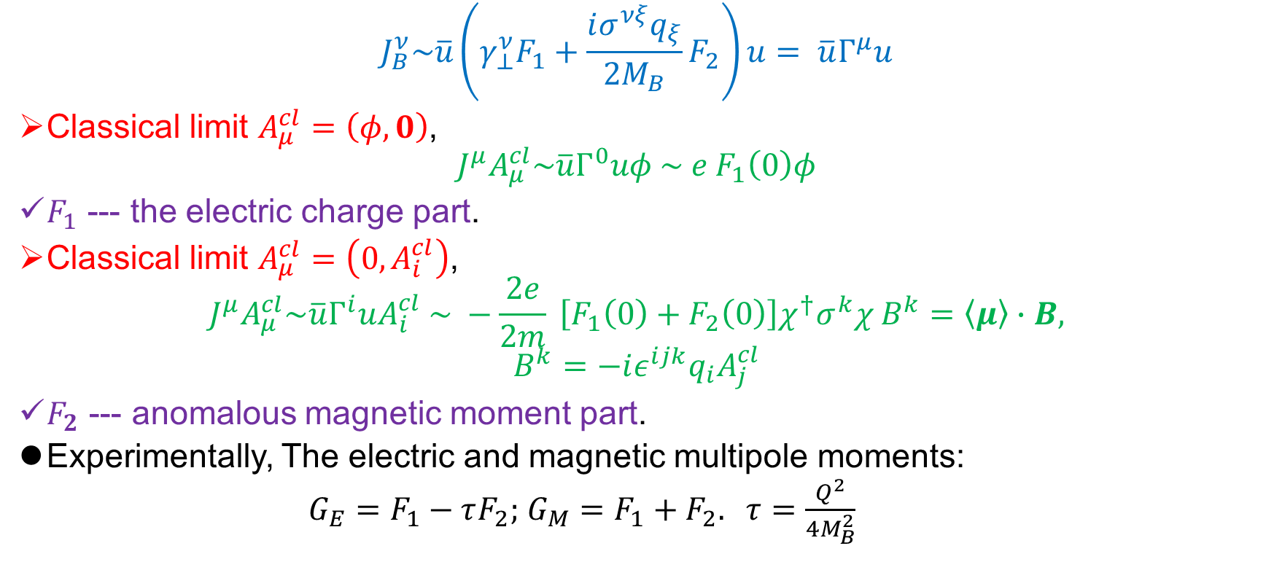
Electromagnetic form factors
$$J_{B}^{ν}\sim \overline{u}\left(γ_{⊥}^{ν}F_{1}+\frac{iσ^{νξ}q_{ξ}}{2M_{B}}F_{2}\right)u= \overline{u}Γ^{μ}u$$
Classical limit $A_{μ}^{cl}=\left(φ, 0\right)$,
$$J^{μ}A_{μ}^{cl}\sim \overline{u}Γ^{0}uφ \sim e F_{1}\left(0\right)φ$$
$F_{1}$ --- the electric charge part.
Classical limit $A_{μ}^{cl}=\left(0, A_{i}^{cl}\right)$,
$$J^{μ}A_{μ}^{cl}\sim \overline{u}Γ^{i}uA_{i}^{cl} \sim −\frac{2e}{2m} \left[F_{1}\left(0\right)+F_{2}\left(0\right)\right]χ^{†}σ^{k}χ B^{k}=\left\langle μ\right\rangle ∙B,$$
$$B^{k}=−iε^{ijk}q_{i}A_{j}^{cl}$$
$F_{2}$ --- anomalous magnetic moment part.
Experimentally, The electric and magnetic multipole moments:
$G_{E}=F_{1}−τF_{2};$ $G_{M}=F_{1}+F_{2}.$ $τ=\frac{Q^{2}}{4M_{B}^{2}}$

Slide 13
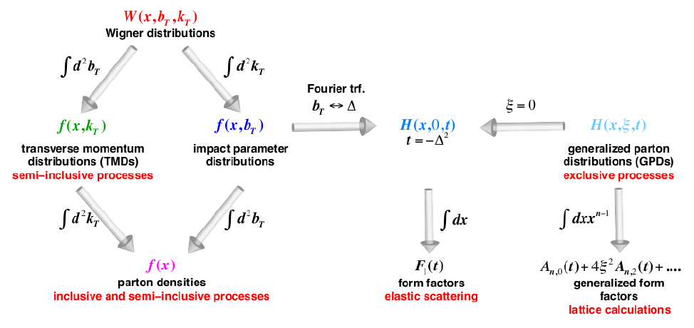
Electromagnetic form factors
Form factors from GPD.
EIC white paper, Eur. Phys. J. A 52, 268 (2016)

Slide 14
Methods

Slide 15
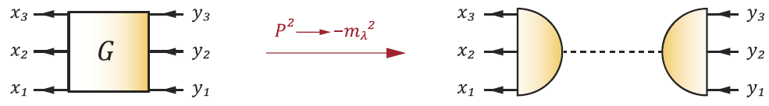
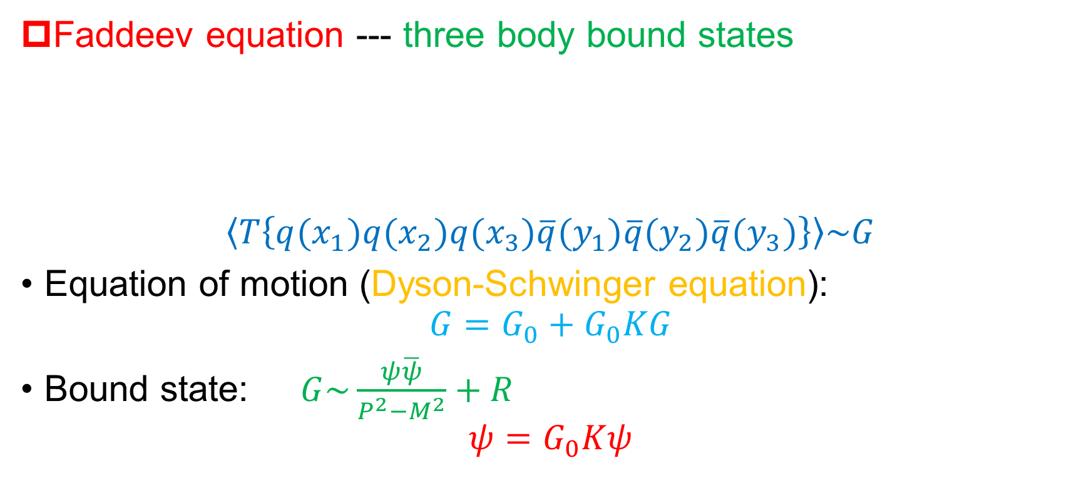
Faddeev equations
Faddeev equation --- three body bound states
$$\left\langle T\left\{q(x_{1})q(x_{2})q(x_{3})\overline{q}(y_{1})\overline{q}(y_{2})\overline{q}(y_{3})\right\}\right\rangle \sim G$$
Equation of motion (Dyson-Schwinger equation):
$$G=G_{0}+G_{0}KG$$
Bound state: $G\sim \frac{ψ\overline{ψ}}{P^{2}−M^{2}}+R$
$$ψ=G_{0}Kψ$$

Slide 16
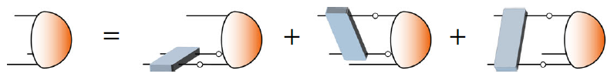
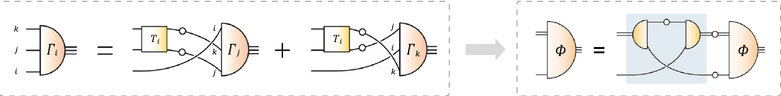
Faddeev equations
Three quark Faddeev equation
Quark-diquark Faddeev equation
G.Eichmann et al. PPNP 91, 1 (2016)
Scalar, axial vector diquarks

Slide 17
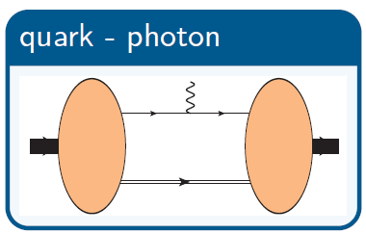
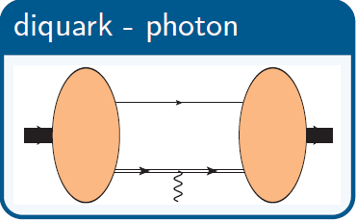
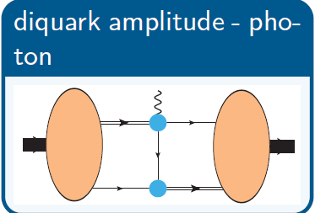
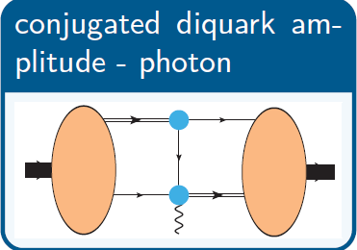
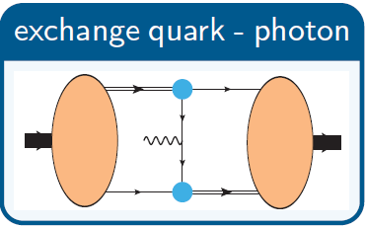
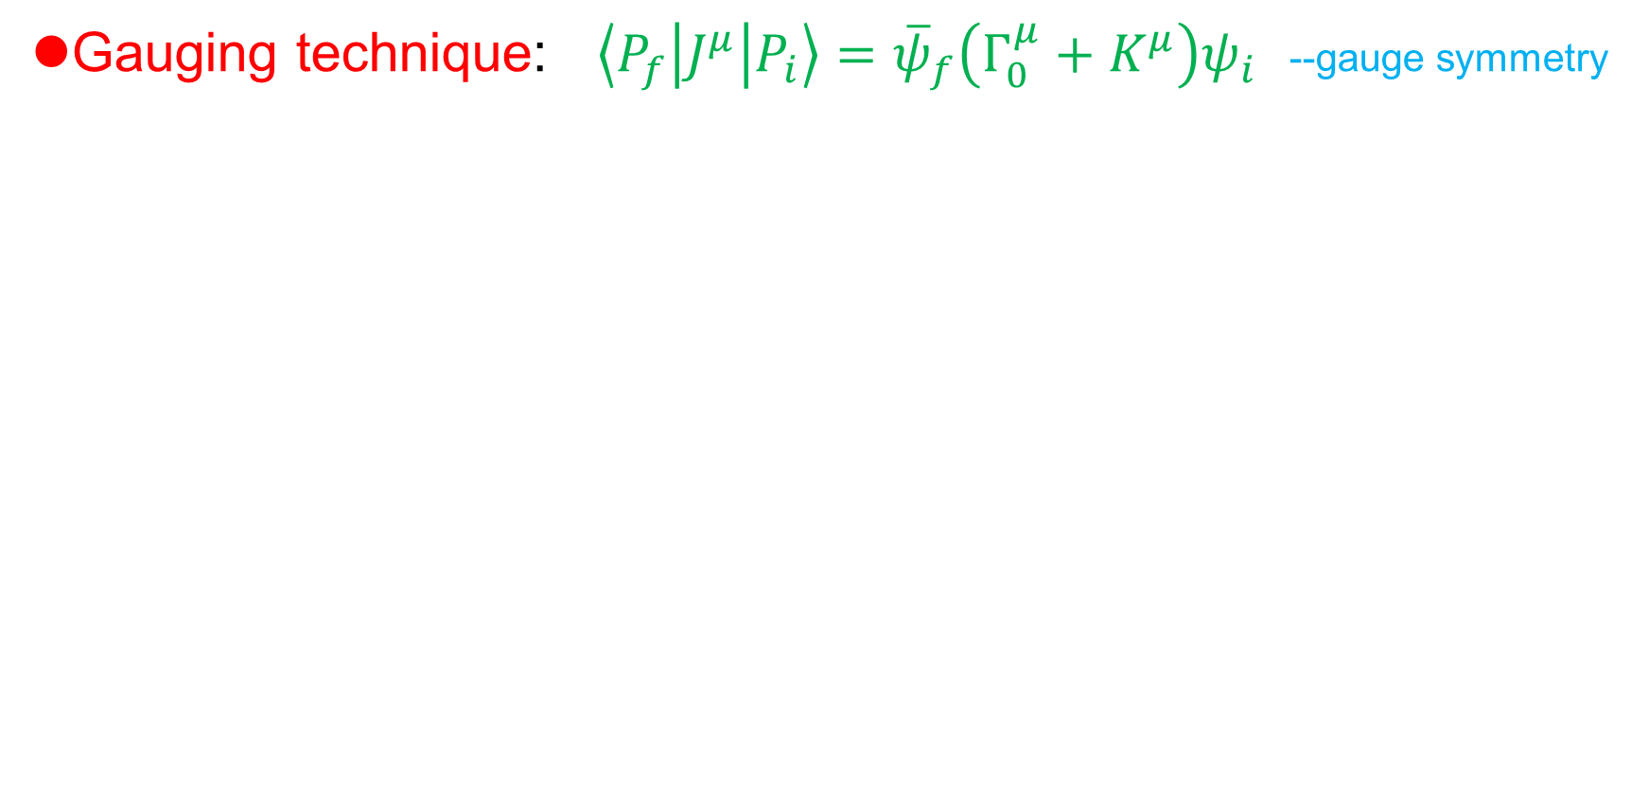
Electromagnetic currents
Gauging technique: $\left\langle P_{f} | J^{μ} | P_{i}\right\rangle ={\overline{ψ}}_{f}\left(Γ_{0}^{μ}+K^{μ}\right)ψ_{i}$ --gauge symmetry

Slide 18
Calculation ingredients

Slide 19
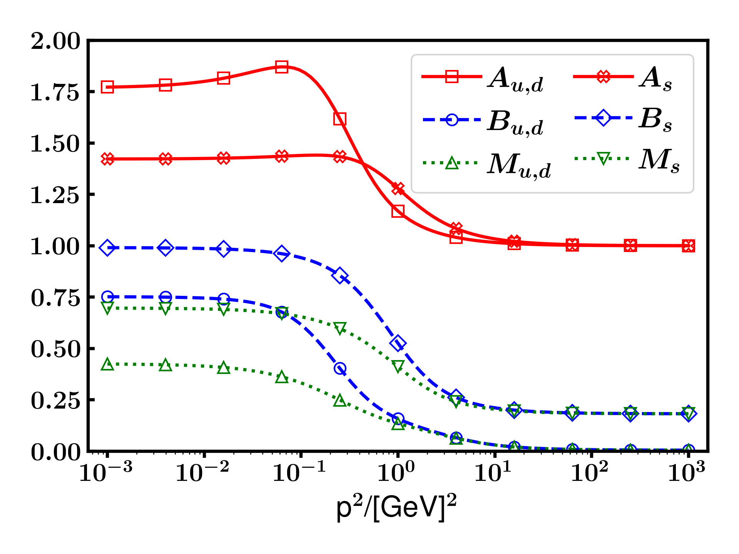
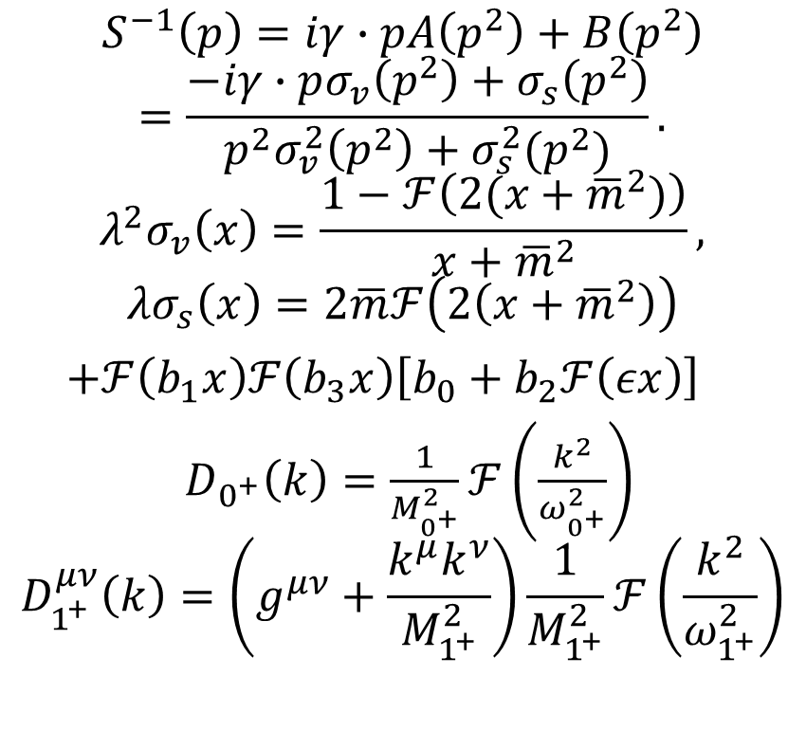
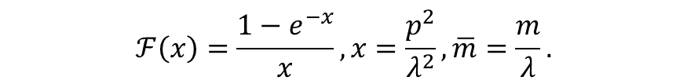
Parameterized quarks and diquarks
$$S^{−1}\left(p\right)=iγ∙pA\left(p^{2}\right)+B\left(p^{2}\right)$$
$$=\frac{−iγ∙pσ_{v}\left(p^{2}\right)+σ_{s}\left(p^{2}\right)}{p^{2}σ_{v}^{2}\left(p^{2}\right)+σ_{s}^{2}(p^{2})}.$$
$$λ^{2}σ_{v}\left(x\right)=\frac{1−ℱ\left(2(x+{\overline{m}}^{2})\right)}{x+{\overline{m}}^{2}},$$
$$λσ_{s}\left(x\right)=2\overline{m}ℱ\left(2\left(x+{\overline{m}}^{2}\right)\right)$$
$+ℱ\left(b_{1}x\right)ℱ\left(b_{3}x\right)\left[b_{0}+b_{2}ℱ\left(εx\right)\right]$
$D_{0^{+}}\left(k\right)=\frac{1}{M_{0^{+}}^{2}}ℱ\left(\frac{k^{2}}{ω_{0^{+}}^{2}}\right)$
$$D_{1^{+}}^{μν}\left(k\right)=\left(g^{μν}+\frac{k^{μ}k^{ν}}{M_{1^{+}}^{2}}\right)\frac{1}{M_{1^{+}}^{2}}ℱ\left(\frac{k^{2}}{ω_{1^{+}}^{2}}\right)$$
$$ℱ\left(x\right)=\frac{1−e^{−x}}{x}, x=\frac{p^{2}}{λ^{2}},\overline{m}=\frac{m}{λ}.$$

Slide 20
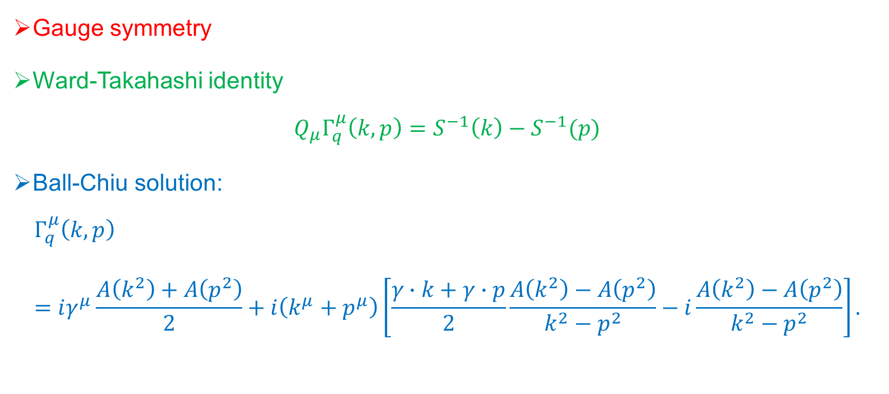
Photon vertexes
Gauge symmetry
Ward-Takahashi identity
$$Q_{μ}Γ_{q}^{μ}\left(k,p\right)=S^{−1}\left(k\right)−S^{−1}(p)$$
Ball-Chiu solution:
$$Γ_{q}^{μ}\left(k,p\right)=iγ^{μ}\frac{A\left(k^{2}\right)+A\left(p^{2}\right)}{2}+i\left(k^{μ}+p^{μ}\right)\left[\frac{γ∙k+γ∙p}{2}\frac{A\left(k^{2}\right)−A\left(p^{2}\right)}{k^{2}−p^{2}}−i\frac{A\left(k^{2}\right)−A\left(p^{2}\right)}{k^{2}−p^{2}}\right].$$

Slide 21
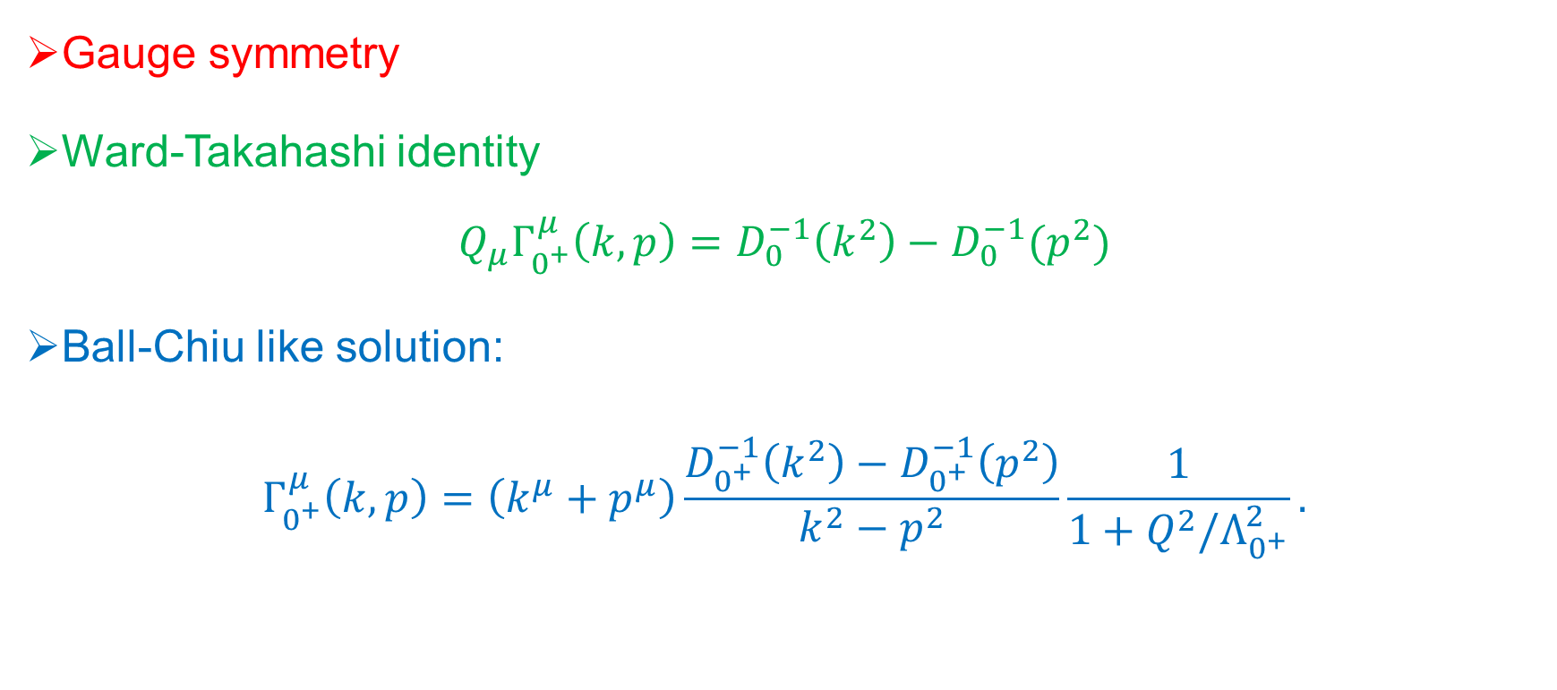
Photon vertexes
Gauge symmetry
Ward-Takahashi identity
$$Q_{μ}Γ_{0^{+}}^{μ}\left(k,p\right)=D_{0}^{−1}\left(k^{2}\right)−D_{0}^{−1}(p^{2})$$
Ball-Chiu like solution:
$$Γ_{0^{+}}^{μ}\left(k,p\right)=\left(k^{μ}+p^{μ}\right)\frac{D_{0^{+}}^{−1}\left(k^{2}\right)−D_{0^{+}}^{−1}\left(p^{2}\right)}{k^{2}−p^{2}}\frac{1}{1+Q^{2}/Λ_{0^{+}}^{2}}.$$

Slide 22
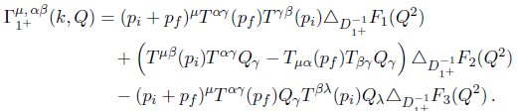
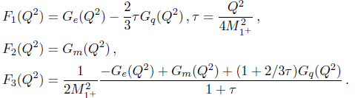
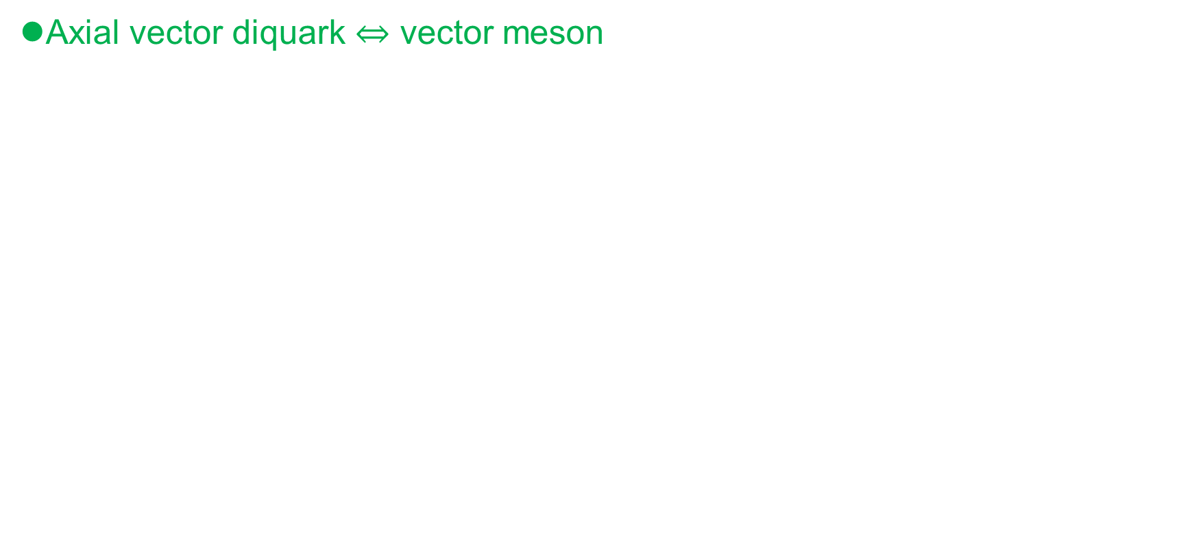
Photon vertexes
Axial vector diquark $⇔$ vector meson

Slide 23
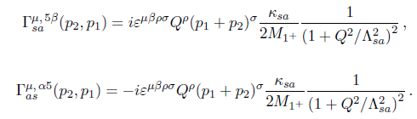
Photon vertexes
Scalar diquark - Axial vector diquark transition
Pseudoscalar meson - Vector meson transition

Slide 24
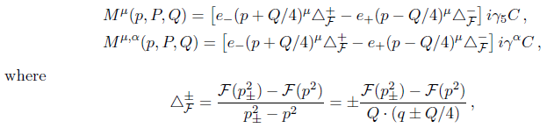

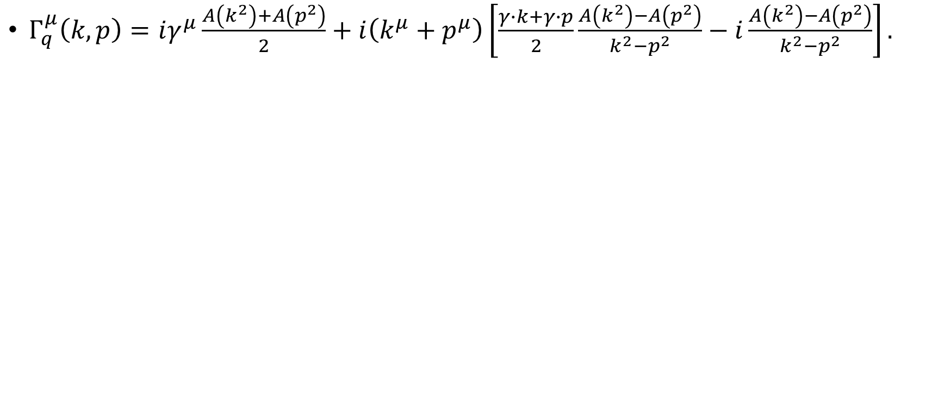
Photon vertex
$Γ_{q}^{μ}\left(k,p\right)=iγ^{μ}\frac{A\left(k^{2}\right)+A\left(p^{2}\right)}{2}+i\left(k^{μ}+p^{μ}\right)\left[\frac{γ∙k+γ∙p}{2}\frac{A\left(k^{2}\right)−A\left(p^{2}\right)}{k^{2}−p^{2}}−i\frac{A\left(k^{2}\right)−A\left(p^{2}\right)}{k^{2}−p^{2}}\right].$

Slide 25
Results

Slide 26
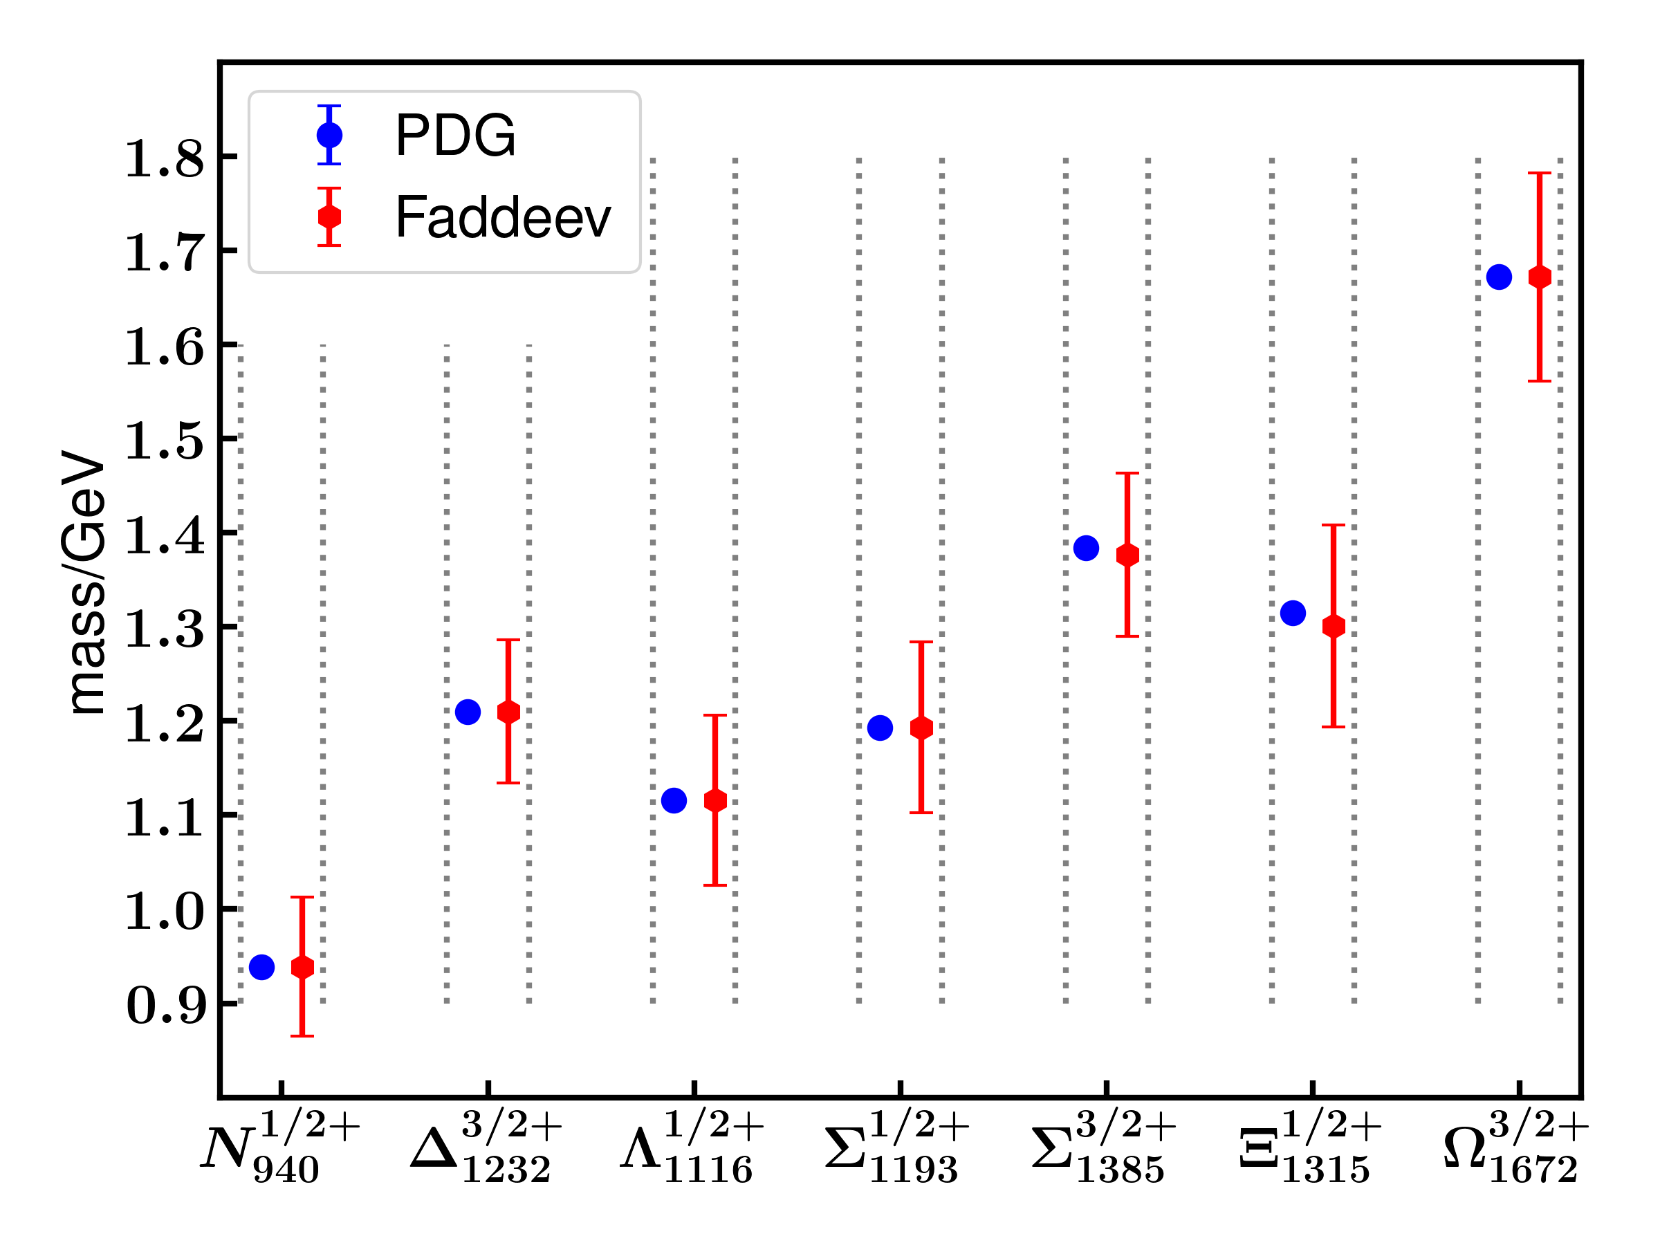
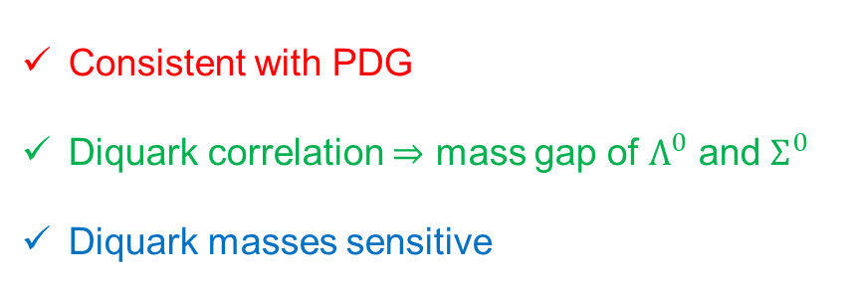
Mass spectrum of some baryons
Diquark | Mass [GeV] | Normalization constant
[ud] | 0.667 | 21.5
{uu},{ud},{dd} | 0.868 | 15.0
[ds],[su] | 0.950 | 17.6
{ds},{su} | 1.06 | 16.0
{ss} | 1.25 | 15.6
L. Liu, C. Fischer, EPJA 60,84 (2024)
Consistent with PDG
Diquark correlation $⇒$ mass gap of $Λ^{0}$ and $Σ^{0}$
Diquark masses sensitive

Slide 27
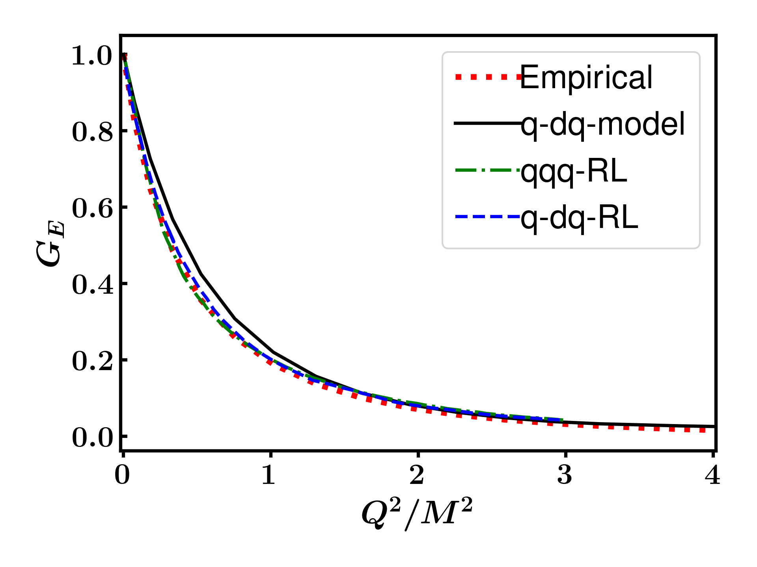
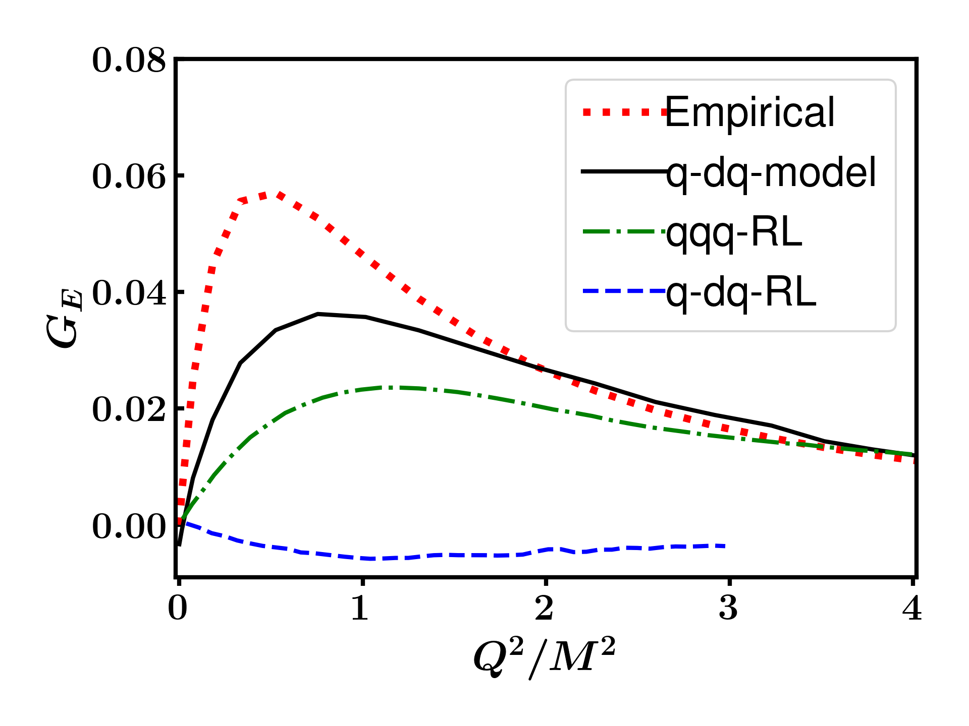
Electromagnetic form factors of nucleon

Slide 28
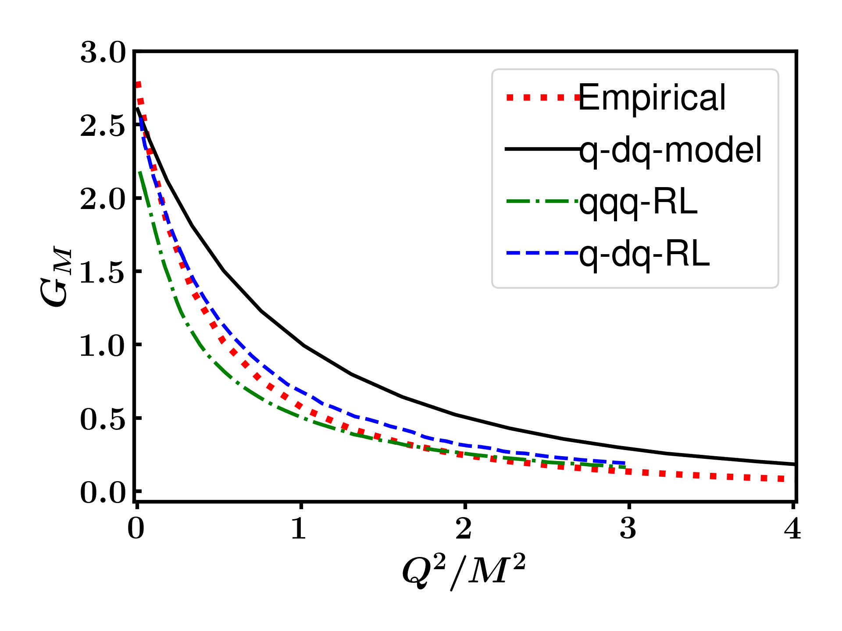
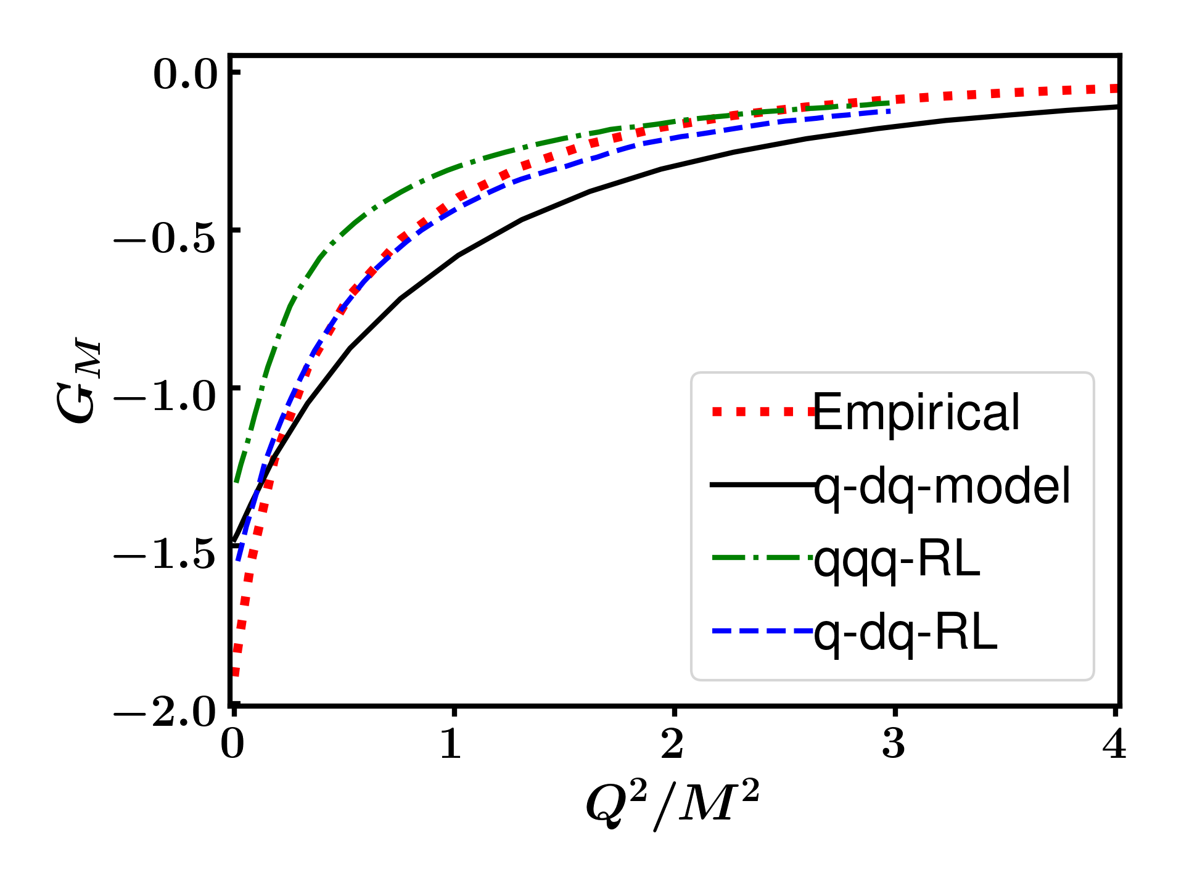
Electromagnetic form factors of nucleon
Only the longitudinal parts are not enough.

Slide 29
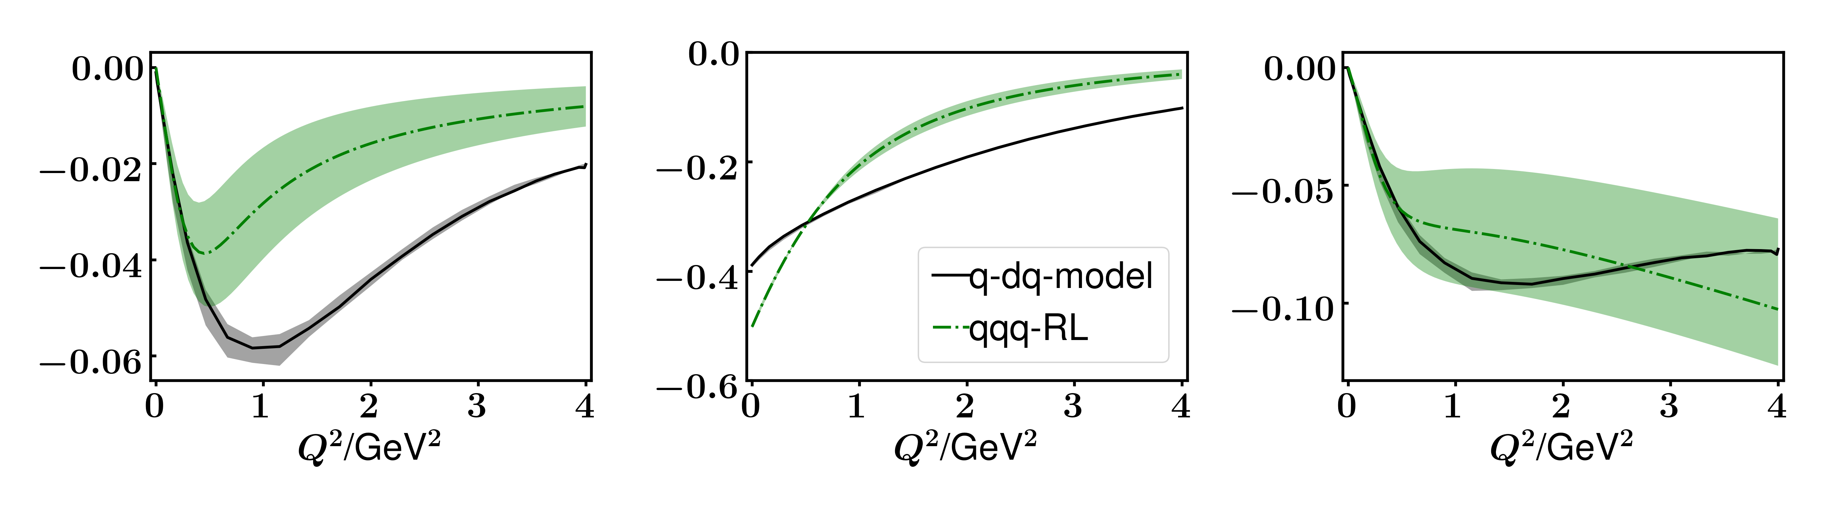
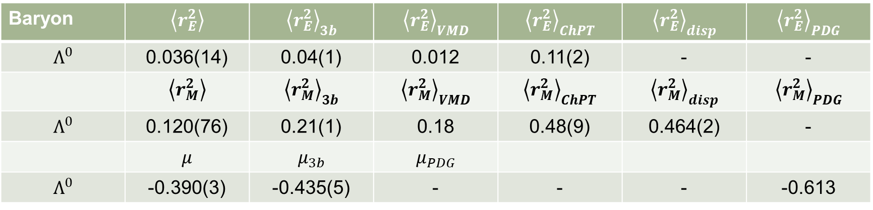
Elastic electromagnetic form factors of $Λ^{0}$
Meet in infrared
Magnitude difference
Baryon | $$\left\langle r_{E}^{2}\right\rangle$$ | $${\left\langle r_{E}^{2}\right\rangle }_{3b}$$ | $${\left\langle r_{E}^{2}\right\rangle }_{VMD}$$ | $${\left\langle r_{E}^{2}\right\rangle }_{ChPT}$$ | $${\left\langle r_{E}^{2}\right\rangle }_{disp}$$ | $${\left\langle r_{E}^{2}\right\rangle }_{PDG}$$
$$Λ^{0}$$ | 0.036(14) | 0.04(1) | 0.012 | 0.11(2) | - | -
 | $$\left\langle r_{M}^{2}\right\rangle$$ | $${\left\langle r_{M}^{2}\right\rangle }_{3b}$$ | $${\left\langle r_{M}^{2}\right\rangle }_{VMD}$$ | $${\left\langle r_{M}^{2}\right\rangle }_{ChPT}$$ | $${\left\langle r_{M}^{2}\right\rangle }_{disp}$$ | $${\left\langle r_{M}^{2}\right\rangle }_{PDG}$$
$$Λ^{0}$$ | 0.120(76) | 0.21(1) | 0.18 | 0.48(9) | 0.464(2) | -
 | $$μ$$ | $$μ_{3b}$$ | $$μ_{PDG}$$
$$Λ^{0}$$ | -0.390(3) | -0.435(5) | - | - | - | -0.613

Slide 30
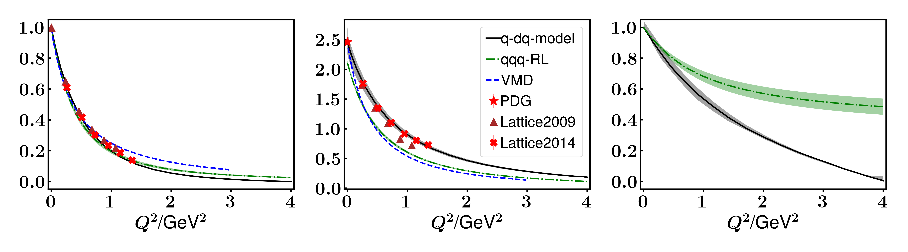
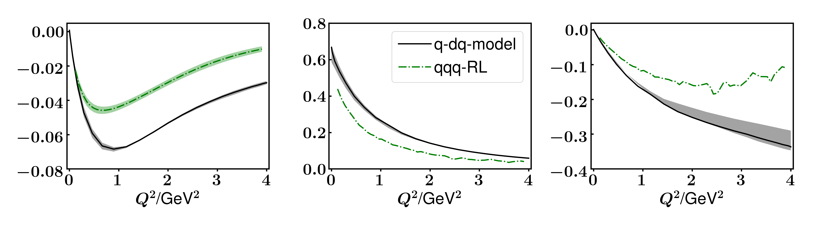
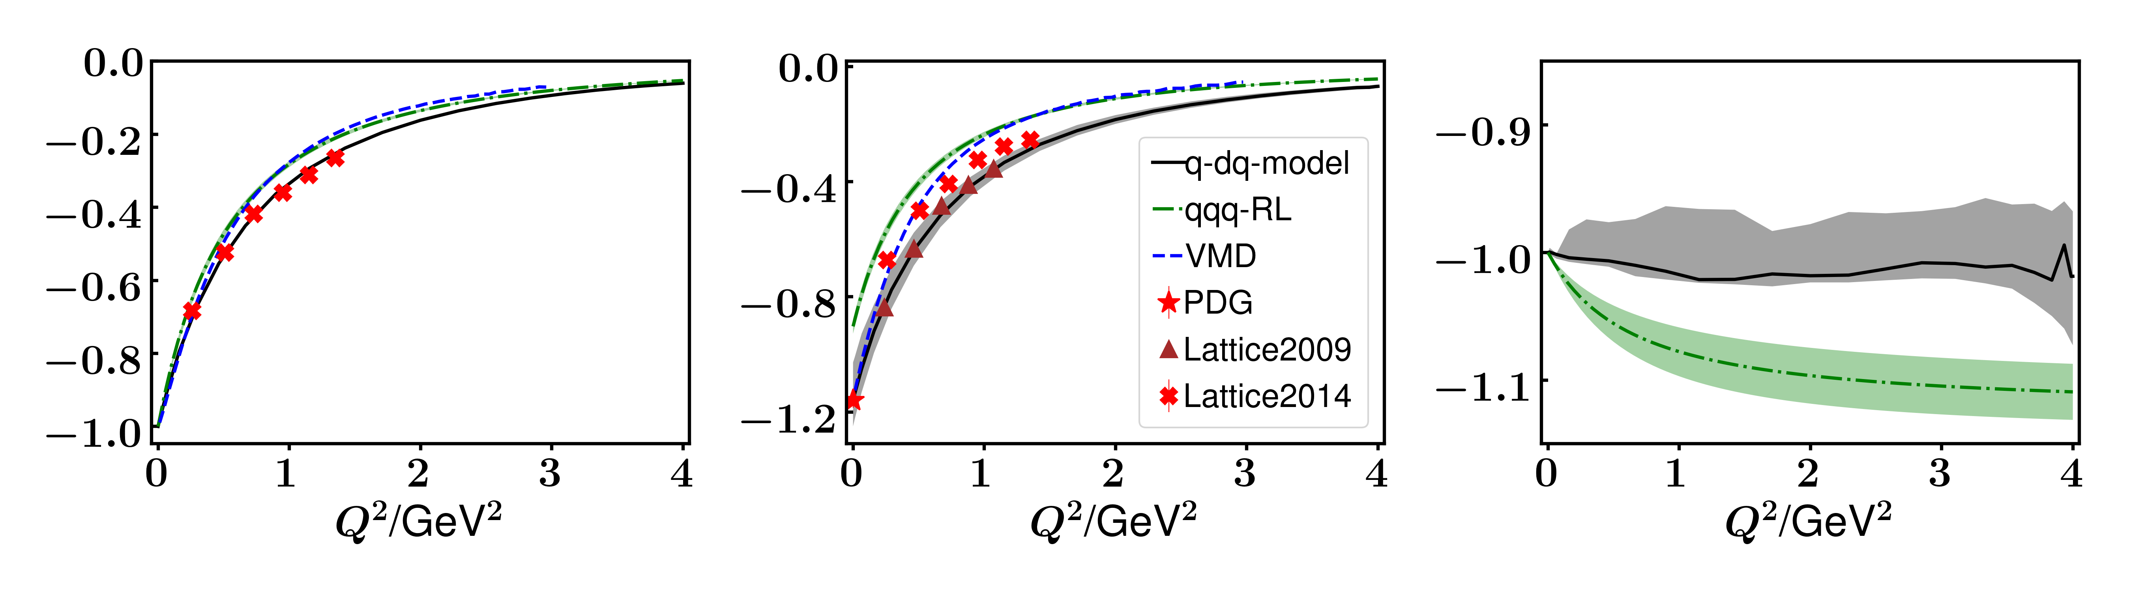
Elastic electromagnetic form factors of $Σ$

Slide 31
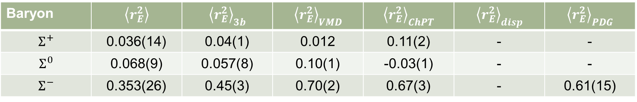


Elastic electromagnetic form factors of $Σ$
Baryon | $$\left\langle r_{E}^{2}\right\rangle$$ | $${\left\langle r_{E}^{2}\right\rangle }_{3b}$$ | $${\left\langle r_{E}^{2}\right\rangle }_{VMD}$$ | $${\left\langle r_{E}^{2}\right\rangle }_{ChPT}$$ | $${\left\langle r_{E}^{2}\right\rangle }_{disp}$$ | $${\left\langle r_{E}^{2}\right\rangle }_{PDG}$$
$$Σ^{+}$$ | 0.036(14) | 0.04(1) | 0.012 | 0.11(2) | - | -
$$Σ^{0}$$ | 0.068(9) | 0.057(8) | 0.10(1) | -0.03(1) | - | -
$$Σ^{−}$$ | 0.353(26) | 0.45(3) | 0.70(2) | 0.67(3) | - | 0.61(15)
Baryon | $$\left\langle r_{M}^{2}\right\rangle$$ | $${\left\langle r_{M}^{2}\right\rangle }_{3b}$$ | $${\left\langle r_{M}^{2}\right\rangle }_{VMD}$$ | $${\left\langle r_{M}^{2}\right\rangle }_{ChPT}$$ | $${\left\langle r_{M}^{2}\right\rangle }_{disp}$$ | $${\left\langle r_{M}^{2}\right\rangle }_{PDG}$$
$$Σ^{+}$$ | 0.374(41) | 0.43(2) | - | 0.80(5) | - | -
$$Σ^{0}$$ | 0.201(169) | 0.39(3) | - | 0.45(8) | - | -
$$Σ^{−}$$ | 0.459(122) | 0.50(1) | - | 1.20(13) | - | -
Baryon | $$μ$$ | $$μ_{3b}$$ | $${μ }_{VMD}$$ | $${μ }_{ChPT}$$ | $${μ }_{disp}$$ | $${μ }_{PDG}$$
$$Σ^{+}$$ | 2.422(180) | 1.82(2) | - | - | - | 2.458(10)
$$Σ^{0}$$ | 0.630(48) | 0.521(1) | - | - | - | -
$$Σ^{−}$$ | -1.145(106) | -0.78(2) | - | - | - | -1.160(25)

Slide 32





Transition form factors of $Σ^{0}γ^{∗}→Λ^{0}$
Numerical error near $Q^{2}=0$
Change slowly $⇒$ localized transition
Similar but magnitude difference
  Gluon differences
  Generic differences between quark-diquark and three-quark pictures.

Slide 33
Conclusion and outlook

Slide 34

Conclusion
Extend the quark-diquark Faddeev equation approach to strange quark sector.
We obtain a mass spectrum consistent with experimental values.
The elastic EMFFs of $Λ$ and $Σ$. We get a good agreement with lattice QCD and other theoretical methods.
The electromagnetic transition form factors of $Σ^{0}γ^{∗}$ → $Λ^{0}$. Same behavior but magnitude difference.

Slide 35

Outlook
Construct transverse part of quark-photon vertex
Compare the results of rest frame with moving frame
$Δ⟹Nγ$
…

Slide 36
Thank you!

